Slide 1
Soldier And Family Readiness Groups
Social Media
Directorate of prevention, resilience and readiness

Slide 2
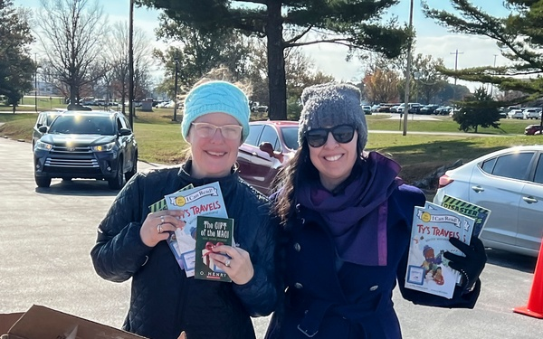
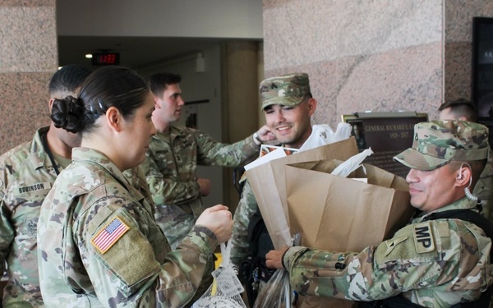
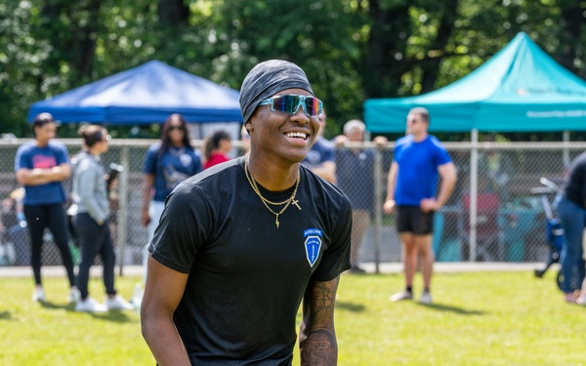
Agenda
Soldier and Family Readiness Group overview
Purpose of SFRG social media
SFRG platforms
Operations security
Social media resources
DPRR

Slide 3
SFRG Overview
Soldier and Family Readiness Groups are crucial to keeping Families up-to-date on critical information while supporting them through their Army journey.
SFRGs are a command-sponsored organization of Family members, volunteers, Soldiers and Army Civilians belonging to a unit that together provide an avenue of mutual support and assistance and a network of communication among the Family members, the chain of command, chain of concern and community resources.
DPRR

Slide 4
Purpose of Social media
SFRGs use social media to connect with Army spouses by sharing what is happening from installation to installation. This includes activities like:
  Fundraising events.
  Classes and trainings.
  Resource information.
  Forums for conversation.
  Community building.
Using social media in this capacity allows spouses and Family members to easily stay informed about SFRG business and outreach.
DPRR

Slide 5
SFRG Social media Platforms
Blogs
Blogs allow space for spouses to share in more detail about their Army experiences and help to enhance a community of support.
Facebook
Facebook allows SFRGs to create a community page. On Facebook, they can plan meetings, share resources, start discussions and post photos.
X
X distributes resources and information in a quick and timely manner to a larger group of followers. It can be easier than using other communication methods or scheduling a monthly meeting.
DPRR

Slide 6

Operations Security
Operations security should always be a primary concern when using social media.
Posting sensitive information can be detrimental to Soldier and Family safety.
Ensure that information posted online is for public distribution and represents Army Values.
DPRR

Slide 7
Operations Security
It’s important that all SFRGs with a social media presence review and abide by the standard operating procedure for official U.S. Army external online presence.
Spouses and Army Families should be trained on basic operations security to include what can and can’t be posted. This includes:
  Asking permission before posting personally identifiable information online.
  Being careful about posting locations on social media platforms.
DPRR

Slide 8
Operations Security
SFRGs should be cautious when accepting requests for new community members and interacting with people online.
SFRGs should never accept a connection request from someone they do not know without further investigation.
SFRGs should not provide too much information in profiles of community members to avoid exposure to people who want to steal identities or other sensitive operational information.
DPRR

Slide 9
Operations Security
Items safe to discuss on social media platforms:
Pride and support for service, units, specialties and service members.
Generalizations about service or duty.
General status of the location of a unit.
Any information already in the public domain posted by official sources.
DPRR

Slide 10
Operations Security
Items that should not be discussed on social media platforms:
Overseas base descriptions, including weapon and equipment systems.
APO addresses for units.
Routine military activities and results of operations.
Future operations, including deployment dates.
Discussions of areas frequented by service members overseas.
Unit morale.
DPRR

Slide 11
Social Media Resources
U.S. Army Social Media Guide
This website will acquaint you with your role in Army social media and provide you with policies, guidance and recommendations on how to become a more effective communicator and representative of the U.S. Army—creating an environment where trusted information is disseminated to the Army Family and the public.
https://www.army.mil/socialmedia
U.S. Army Information on Registering an Official Account
All accounts created and managed using federal government resources (including time, manpower and funds) to communicate the work of the Army must be registered.
https://www.army.mil/socialmedia/official/#registration
DPRR

Slide 12
Social Media Resources
Facebook Community Page Creation
https://www.facebook.com/pages/create
Facebook Privacy Center
https://www.facebook.com/privacy/center
X Privacy Policy
https://x.com/en/privacy
DPRR

