Slide 1
SOLDIER And Family Readiness Group Social Media:
Considerations for Deployed Soldiers and Their Families
Directorate of prevention, resilience and readiness

Slide 2

Agenda
We all depend on social media in our daily lives to stay connected and informed, but these connections can pose risks during deployment for both Soldiers and their Families. Here are a few areas to review to stay ready and resilient:
Online conduct
Profile management
Privacy settings
Location sharing
Educating your Family
DPRR

Slide 3
Online Conduct
Soldiers and their Families are personally responsible for all content they publish on social networking sites. As members of the Army profession and Family, all are expected to live the Army Values, both online and offline.
Soldiers must be thoughtful about mission-related and non-Soldier content they post, as the lines between personal and professional can easily blur.
Soldiers who violate federal law, regulations or policies through inappropriate personal online activity are subject to disciplinary action under the Uniform Code of Military Justice.
Commenting on or posting material that violates the UCMJ or basic rules of Soldier conduct is prohibited, along with talking negatively about supervisors or releasing sensitive information.
DPRR

Slide 4
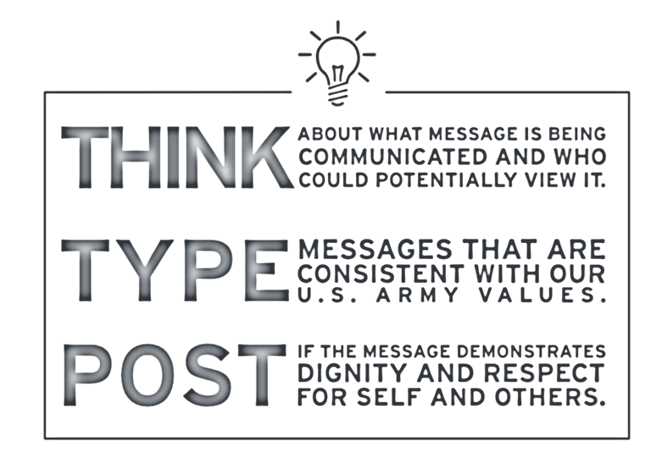
Online ConDuct
Soldiers and their Families should avoid:
Posting internal Army documents or information that the Army has not officially released to the public. This includes information about casualties, detainees or military operations.
Using DOD titles, insignia, uniforms or symbols in a way that could imply DOD sanction or endorsement of content on your personal page.
Misrepresenting yourself as an official DOD spokesperson on your personal account.
DPRR

Slide 5
PROFILE MANAGEMENT
Connection Requests
Be cautious when accepting requests and interacting with people online.
Soldiers should never accept a friend request from someone they do not know, even if that individual is connected to their network.
Profile Information
Soldiers might be targeted simply because they work in the DOD. Be cautious when listing job, military organization, education and contact information.
Providing too much information in a profile can leave Soldiers exposed to people who want to steal their identity or sensitive operational information.
DPRR

Slide 6
Privacy Settings
Understanding what can and cannot be posted on social media platforms can help protect yourself online, but more can be done by adjusting your privacy settings on social media sites. A few concepts for consideration:
  Many default privacy settings are often set to public. Review your setting options to control who can access and view your information.
  Always use strong passwords and consider using two-factor authentication.
  Regularly review permission controls to manage what data applications can access.
DPRR

Slide 7
Location Sharing
It is common practice for users to be able to share their location on smartphones, fitness trackers and social media platforms.
Geotagging is the process of adding geographical identification to photographs, videos, websites and SMS messages. It is the equivalent of adding a 10-digit grid coordinate to everything a user posts on the internet.
Search engines factor in a user's location when displaying search results, which opens the potential for privacy concerns when surfing the internet.
Soldiers conducting operations in classified areas should not use location-based social platform services, as they leave them exposed to vulnerabilities.
Soldiers should disable GPS and other location sharing functions on their smartphones and social media platforms.
DPRR

Slide 8
Educating Your Family
Social media helps Solider and Family Readiness Groups and Army Family members stay connected, but security should always be the primary concern. Families should understand:
The expectations of their Soldier regarding operations security and what can and cannot be posted.
Privacy settings should be reviewed on all social media platforms to ensure safe management of information.
Posting sensitive information can be detrimental to Soldier safety. This includes:
  Posting about a deployment or redeployment.
  Sharing schedules and event locations.
DPRR

Slide 9
Educating Your Family
Soldiers and Families should think about what they are posting before hitting “Share.” Many times, releasing sensitive information can be avoided by simply rephrasing the post. Review the examples below:
Dangerous | Safer
My Soldier is in XYZ at ABC Camp in ABC City. | My Soldier is deployed to Europe.
My Soldier is coming back at XYZ time on XYZ day. | My Soldier will be home this summer.
My family is back in Edwardsville, Illinois. | I’m from the Midwest.
DPRR

Slide 10
Educating Your Family
Social media can help Solder and Family Readiness Groups and Army Family members stay motivated during deployment by celebrating their Soldier’s commitment. Families should understand that they
can post about:
Pride and support for service, units, specialties and service members.
Generalizations about service or duty.
General status of a unit’s location.
Any other information already in the public domain posted by official sources.
DPRR

Slide 11
Social Media Resources
U.S. Army Social Media Guide
This website will acquaint you with your role in Army social media and provide you with policies, guidance and recommendations on how to become a more effective communicator and representative of the U.S. Army—creating an environment where trusted information is disseminated to the Army Family and the public.
https://www.army.mil/socialmedia
Facebook Privacy Center
https://www.facebook.com/privacy/center
Instagram Privacy Information
https://help.instagram.com/811572406418223/?helpref=uf_share
X Privacy Information
https://x.com/en/privacy
DPRR

