Slide 1

Notes:
Directions (Approximately 5 minutes) have a sign-in sheet near the door and Slide 1 displayed as training participants enter the room. Arrange chairs in small groups if possible or designate small group seating areas by directing Army Civilians to seating as they enter the room. (This training is most effective when used with a maximum class size of 30 and a minimum class size of 8.) Introduce yourself and provide housekeeping information such as the location of rest rooms. Read the Example Speaker’s Notes in the ACE for Army Civilians Facilitator’s Handbook for additional information and then use the talking points to introduce the training in your own words.
Talking Points:
Option to be excused from this training and receive training by an alternate method.
Course Title/sign-in for credit for annual requirement.
Housekeeping details.
Speak with me first if you need to leave the training.
Someone is standing by to talk if anyone needs to do so.
Put the National Suicide Prevention Lifeline number (1-800-273-TALK (8255) in the contact list of your mobile - turn off sound.
Protect privacy of others as we discuss things.
Suicide rate rising across U.S. has risen; this is an issue that touches all of us.
Show of hands – who would know how to give CPR if we had an emergency in our classroom? ACE (ASK, CARE, ESCORT) training prepares you to give assistance for an emergency too. It can help you become AWARE of warning signs; COMMITTED to helping yourself and others; and EFFECTIVE at locating the resources you need to do that!
Today you will learn to use the A-C-E method to help prevent suicides.

Slide 2
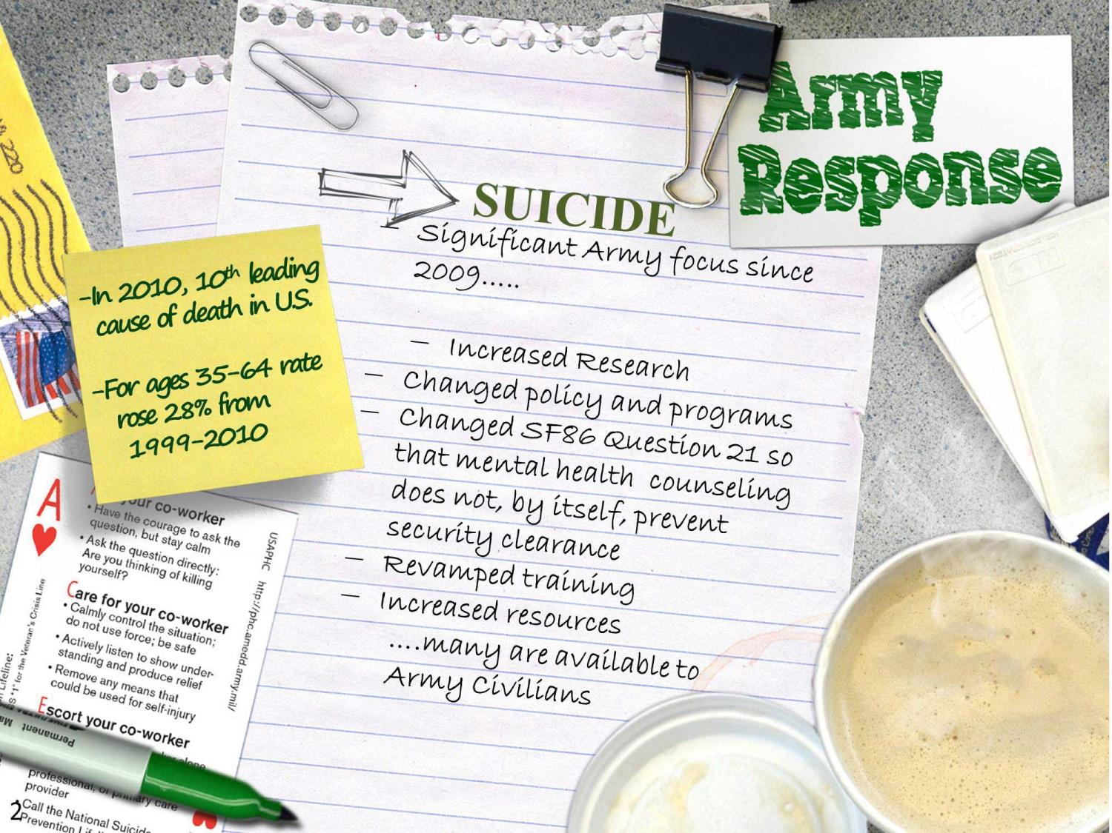
Notes:
Directions (Approximately 4 minutes): Display slide 2. Read the Example Speaker’s Notes in the ACE for Army Civilians Facilitator’s Handbook for additional information for this slide and then use the talking points to discuss the slide in your own words.
Talking Points:
Suicides occur among all groups
Suicide causes are complex requiring a community health prevention approach by the Army
Research and efforts to prevent suicide are ongoing but there is no single solution
Changes to Question 21 of the SF86 Questionnaire for National Security Positions so that seeking counseling does not, by itself, preclude obtaining a security clearance
CSF2 tools and resources are available to Army Civilians
Other resources for Army Civilians discussed later
Civilian statistics on slide from Center for Disease Control and Prevention (CDC)

Slide 3
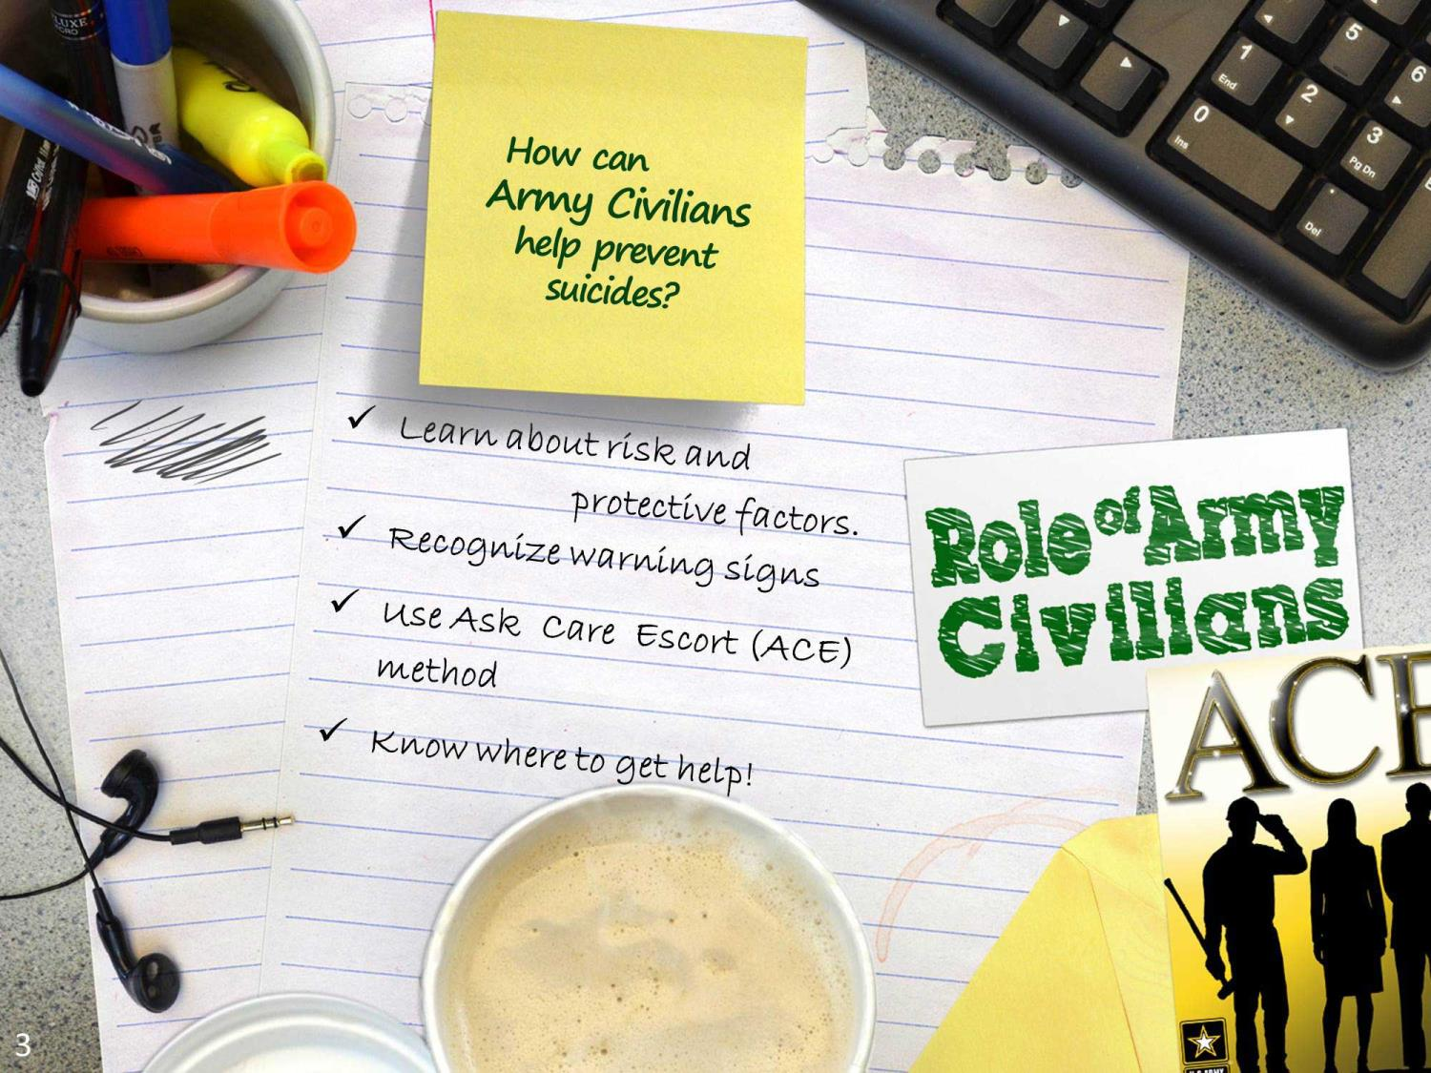
Notes:
Directions (Approximately 3 minutes): Read the Example Speaker’s Notes in the ACE for Army Civilians Facilitator’s Handbook for additional information and then use the talking points to discuss the slide in your own words. Ask questions and allow time for responses from the group. Listen to answers, ask follow on questions, or provide corrections and additional information as required.
Talking Points:
Do Army Civilians have a role in helping prevent suicides?
What can you do personally to help prevent suicides?
Learn about risk and protective factors.
Recognize warning signs and respond appropriately using the ACE Method.

Slide 4
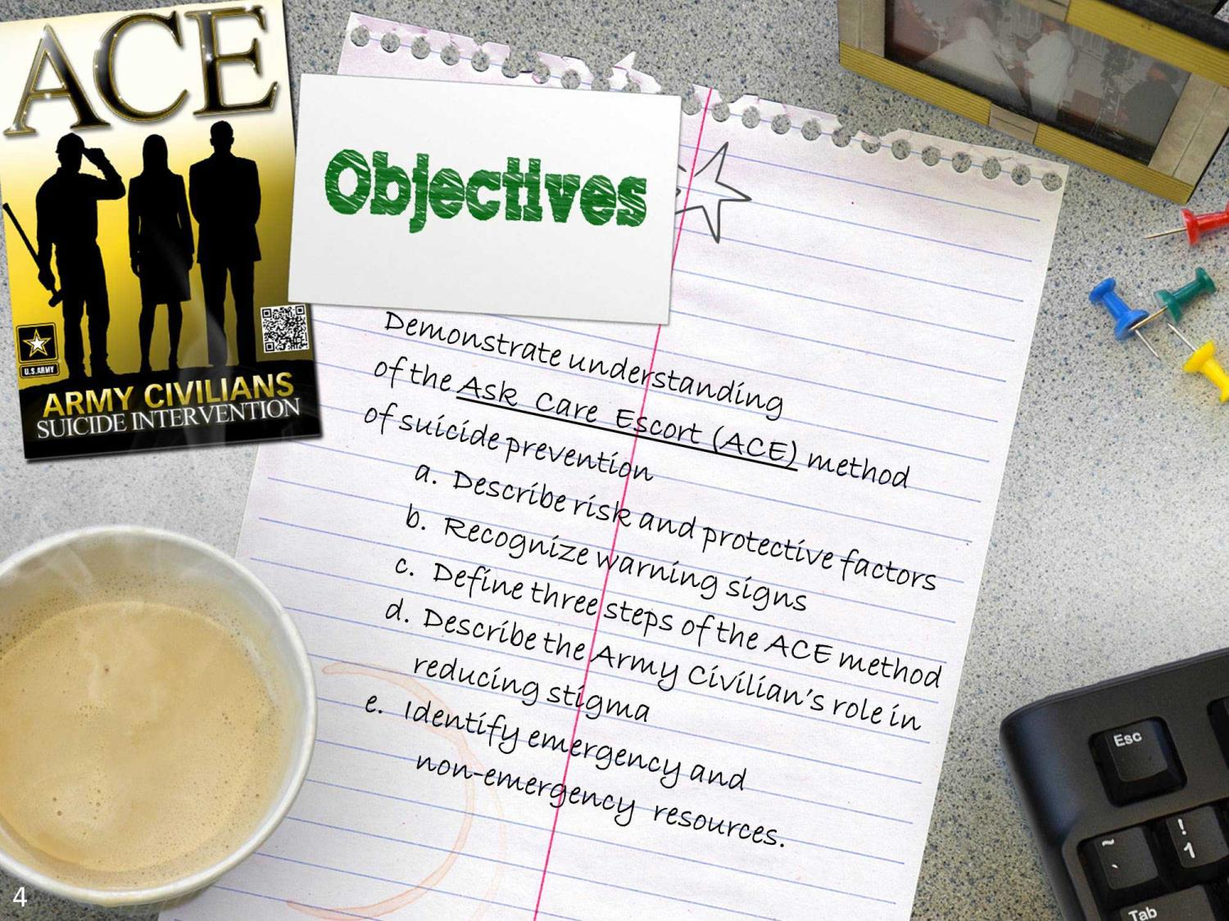
Notes:
Directions (Approximately 2 minutes): Display the slide and briefly point out the Terminal Learning Objective and the Enabling Learning Objectives. Read the Example Speaker’s Notes in the ACE for Army Civilians Facilitator’s Handbook for additional information.
Talking Points:
At the end of today’s ACE for Army Civilians training you will be able to demonstrate an understanding of the ASK, CARE, ESCORT or ACE method of suicide prevention.
In order to demonstrate your understanding of the ACE method you will be able to
Describe the risk and protective factors that impact suicide.
Recognize warning signs of suicide.
Define the three steps of the ACE method of suicide prevention.
Describe the Army Civilian’s role in reducing and preventing stigma.
Identify emergency and non-emergency resources.

Slide 5

Notes:
Directions (Approximately 3): Use the Talking Points to discuss this slide. To get additional ideas and information to help you facilitate this section, read the Example Speaker's Notes in the ACE for Army Civilians Facilitator’s Handbook.
Talking Points:
Everyone has both risk factors and protective factors and stressors in their lives all the time.
Most of the time we can balance these; but there are times when everyone needs some help to do that.
When risk factors start to throw us off balance it is time to get help—talk to a friend and share the load: talk to the your supervisor, your EAP representative, your primary care physician, or your religious advisor in order to locate the right kind of help for you.
What should you do about risk?
Compensate for risks that you cannot change.
Increase your protective factors.
Build strong relationships: Family, friends, groups.
Avoid high risk behaviors like heavy drinking.
Get help when you need it—the earlier you get help with problems the faster you can get your life back in balance!
Individual Activity/Exercise

Slide 6
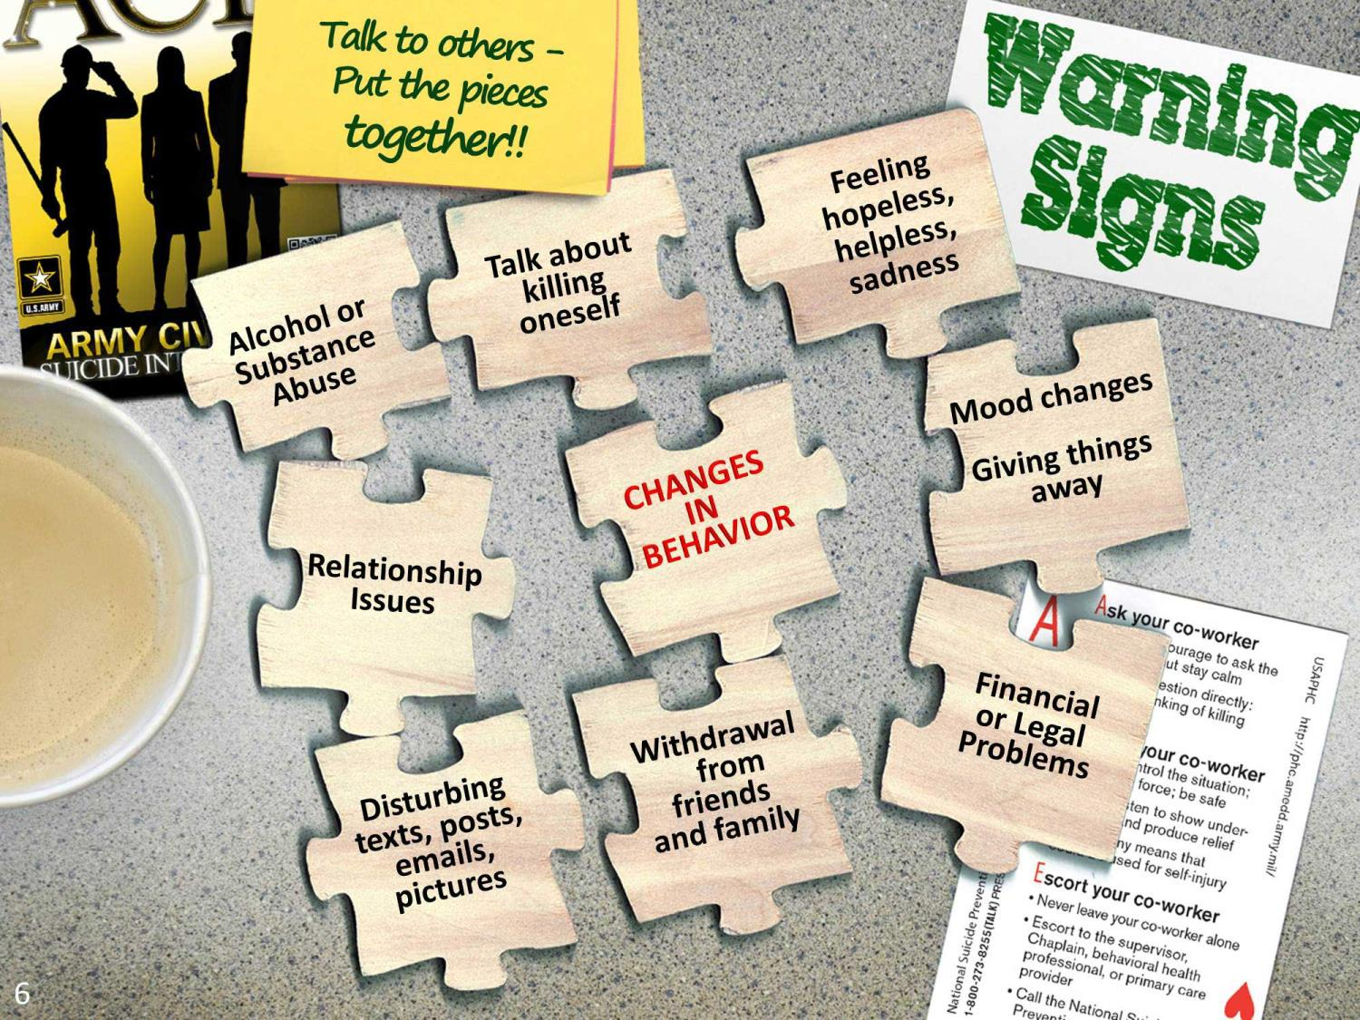
Notes:
Directions (Approximately 3 minutes): Display slide 6 as you discuss the talking points. To get additional ideas and information to help you facilitate this section, read the Example Speaker's Notes in the ACE for Army Civilians Facilitator’s Handbook.
Talking Points:
When you see a warning sign, that is when you use ACE. Let’s talk about it.
Warning signs are different than risk factors.
A warning sign is a cry for immediate help—a signal that something is very wrong right now!
Talk to people. Get to know them so that you recognize a change in behavior.
Never ignore a warning sign – apply the three steps of the ACE method. We’ll practice the ACE method in the next part of our training.

Slide 7
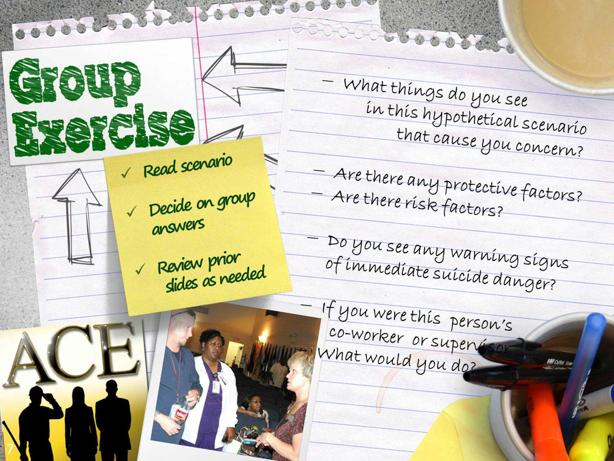
Notes:
Directions (Approximately 20 minutes [10 minutes per exercise]): Divide training participants into groups of 6 to 8 individuals. The instructions for Group Exercises appear on Slide 7. Select two exercises from among the exercises in Appendix A. Prior to conducting the training, print copies of the two that you have selected so that each training participant has a copy. Instruct groups to read the exercises one at a time and then – as a group—decide on answers to the questions posed at the beginning of each exercise. Allow the groups to work for 6 to 7 minutes and then ask for shout outs from the groups to answer the questions. Allow discussion if there are differences of opinion about courses of action to choose. (Use a total of about 10 minutes per exercise for small group discussions, shout outs, and class discussion.) Possible answers to the questions for each exercise are included in Appendix B for your reference and use in facilitating this section of the training. (If questions arise about risk/protective factors or warning signs, display Slides 5 and 6 again as required.)
Talking Points:
Work in groups with 6 to 8 people in each group
Read the first exercise and as a group decide on answers to the questions
We will discuss the first exercise as a class and then work in our groups to do the same for the second exercise

Slide 8
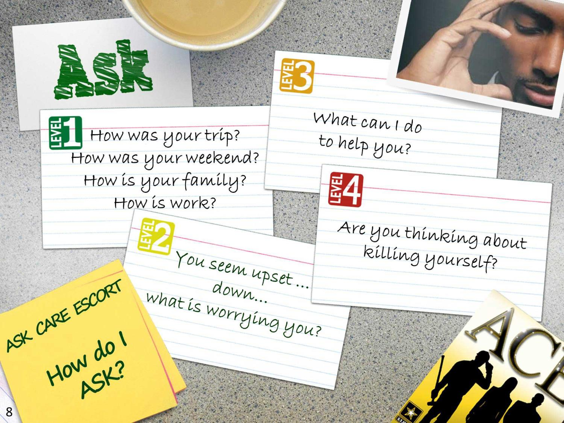
Notes:
Directions (Approximately 3 minutes): Use the talking points to discuss how to ask about suicide. To get additional information and ideas regarding how to facilitate this section, read the Example Speaker's Notes.
Talking Points:
Use ACE when you see warning signs
First step of ACE is to ASK directly about suicide thoughts or plans if one or more warning signs are present.
Asking about suicide does not suggest the thought to someone; it shows them you care and it is ok to talk about it. Don’t be afraid to ask.
Stay calm; don’t judge the person; don’t minimize their problem.
Don’t ignore suicide warning signs, statements, or threats of suicide.

Slide 9
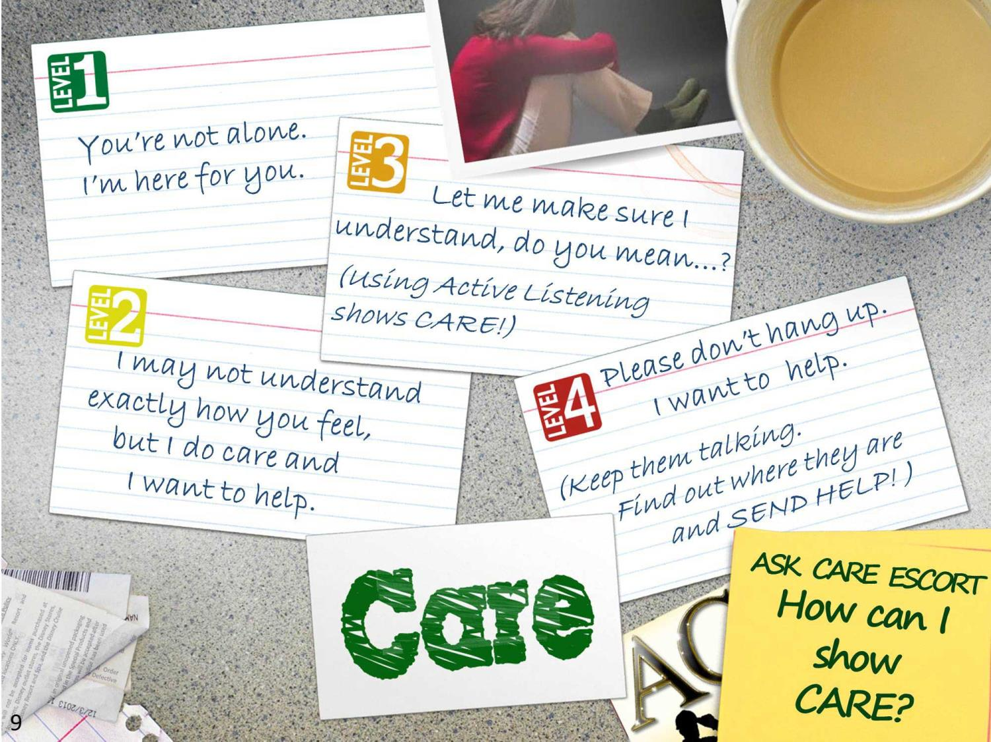
Notes:
Directions (Approximately 3 minutes): Use the talking points to discuss how to show care for a person who may have suicide thoughts. To get additional information and ideas regarding how to facilitate this section, read the Example Speaker's Notes.
Talking Points:
Show CARE by listening and reassuring the person
Do not use force but encourage the person and reassure them that immediate help is available
Use active listening to make sure you understand what they are saying (we will learn more about active listening after the break)

Slide 10
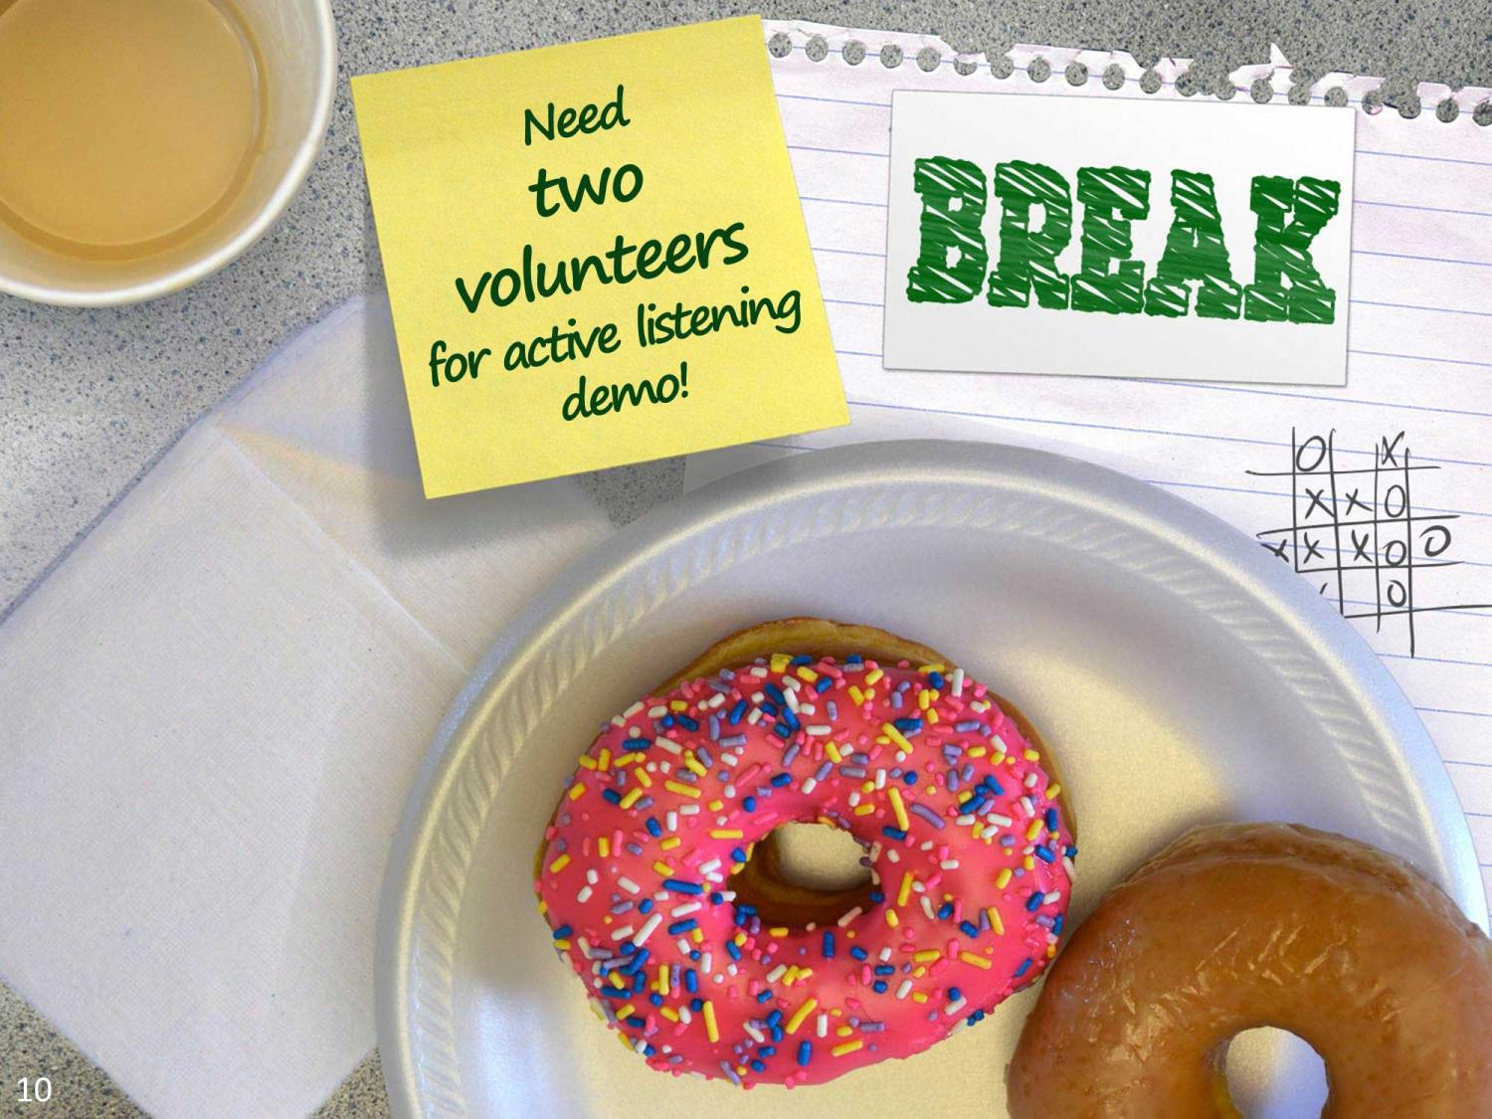
Notes:
Directions (Approximately 10 minutes): Ask for two volunteers to do a class demonstration on active listening after the break.
Give the class a ten minute break (brief the two volunteers during the break so that they can perform the active listening demonstration at end of break. You can print out the information that they need ahead of time, read the information to them, or allow them to read it from your ACE for Army Civilians Facilitator’s Handbook. Tell the volunteers that the demonstration should last about two minutes.)

Slide 11
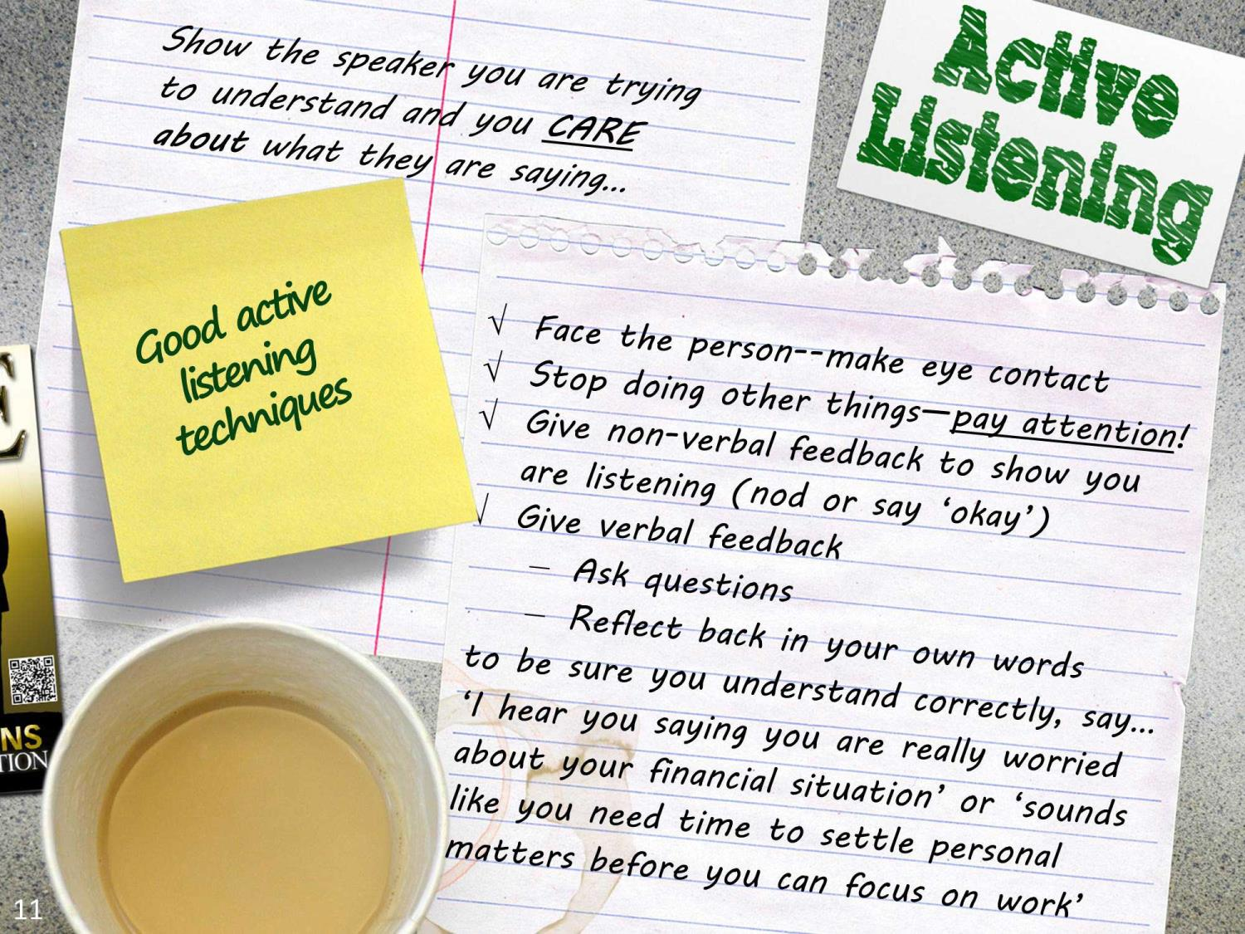
Notes:
Directions (Approximately 10 minutes to include Active Listening Demo): Leave Slide 10 (the Break slide) displayed as you allow the volunteers 1 to 2 minutes to demonstrate POOR listening. Then stop the demo, thank the volunteers and ask for suggestions from the class for what they did wrong. Then display Slide 11 and point out the above good listening techniques. Remind training participants that active listening is part of using ACE to ASK questions so that you understand the situation and can respond appropriately; and to demonstrate that you CARE about the person and the problems they are having.
Talking Points:
Using good listening techniques can help you to demonstrate care and concern for the person you are speaking with
Active listening does not need to solve the person’s problem but can provide relief by letting them know you are trying to understand their situation and you are concerned for them
Ask for shout outs from the class on how the supervisor could have better handled the situation

Slide 12
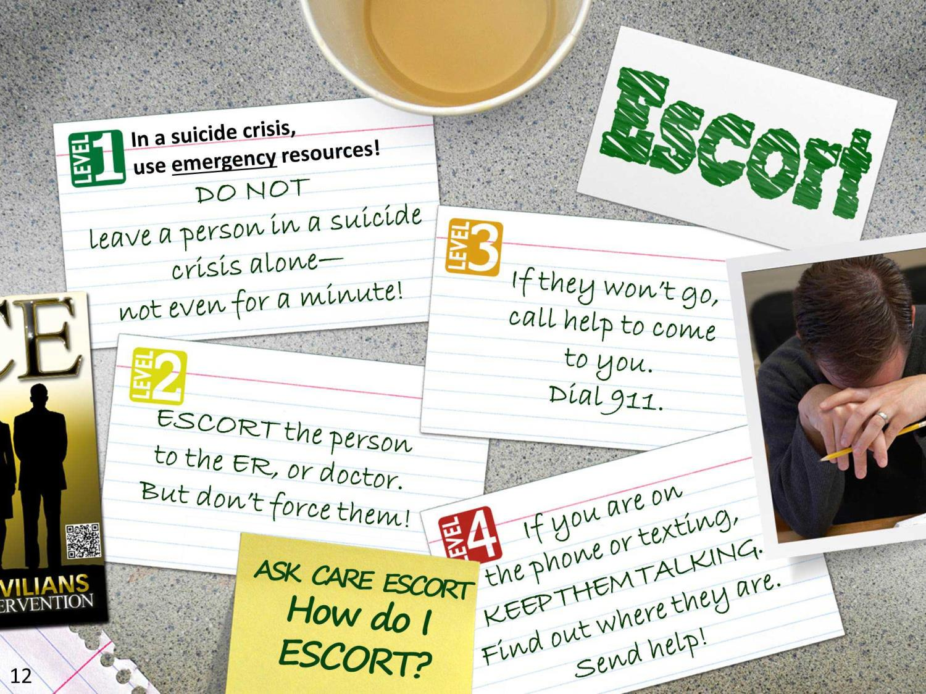
Notes:
Directions (Approximately 3 minutes): Use the talking points to discuss how to escort someone for help. To get additional information and ideas regarding how to facilitate this section, read the Example Speaker's Notes. Hand out local resource list prepared earlier, or point out the list you put on the whiteboard or flip chart. Put the National Suicide Prevention Lifeline number/key local numbers into mobile devices.
Talking Points:
ESCORT means that you stay with the person to keep them safe.
Go with them to the ER or doctor.
Call help to come to you if needed by calling 911, the police, or the MPs if you work on a military installation.
Or use the National Suicide Prevention Lifeline number.
We will discuss resources in detail later in this training.
Hand out list of local numbers. Put Crisis Line and emergency numbers in mobile device contacts list

Slide 13
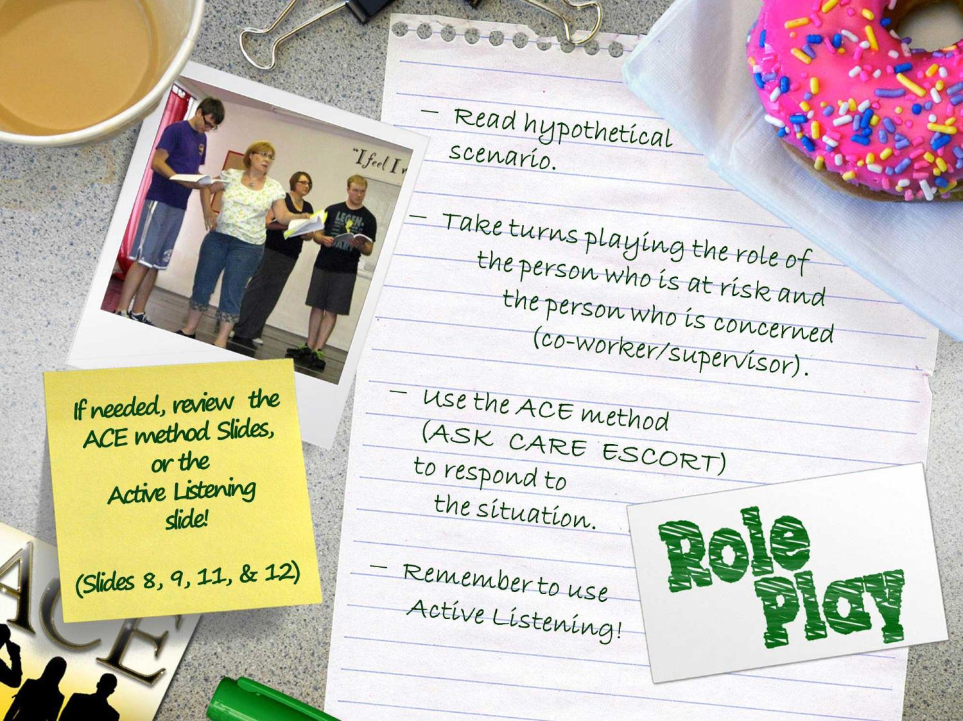
Notes:
FACILITATOR NOTE:
If someone seems very uncomfortable at playing a role or does not wish to take part in the exercise, do not force their participation or expose them to undue attention in front of the group. Make an opportunity to speak privately with the training participant who is uncomfortable and use the ACE method to assess the situation and offer help.
Directions (Approximately 15 minutes): Select one exercise from among the exercises in Appendix A. Prior to conducting the training print copies of the exercise so that each training participant has a copy. (If desired you can do the role play exercise using one of the two exercises that you used earlier in the training during the risk and warning sign exercises.) Instruct groups to read the exercise then take turns playing the role of the person at risk and the person who is concerned (co-worker or supervisor) and will use the ACE method (ASK, CARE, and ESCORT) to intervene in the situation. Circulate through the room to assist the groups and keep training participants on task. At the conclusion, as a lead-in to the stigma discussion, ask participants for shout outs about why it is hard to ask about suicide.
Talking Points:
Divide training participants into groups of two
Classroom Activity/Exercise

Slide 14

Notes:
Directions (Approximately 3 minutes): Display the slide as you use the talking points to discuss stigma. Read the Example Speaker’s Notes for additional information and a sample of how you can facilitate this section of the training.
Talking Points:
Even in a role play in a classroom it is hard to ask the question.
Stigma is all the factors that make people reluctant to ask for help.
Getting the help you need early prevents problems worsening.
List things Army Civilians can do to prevent stigma.

Slide 15
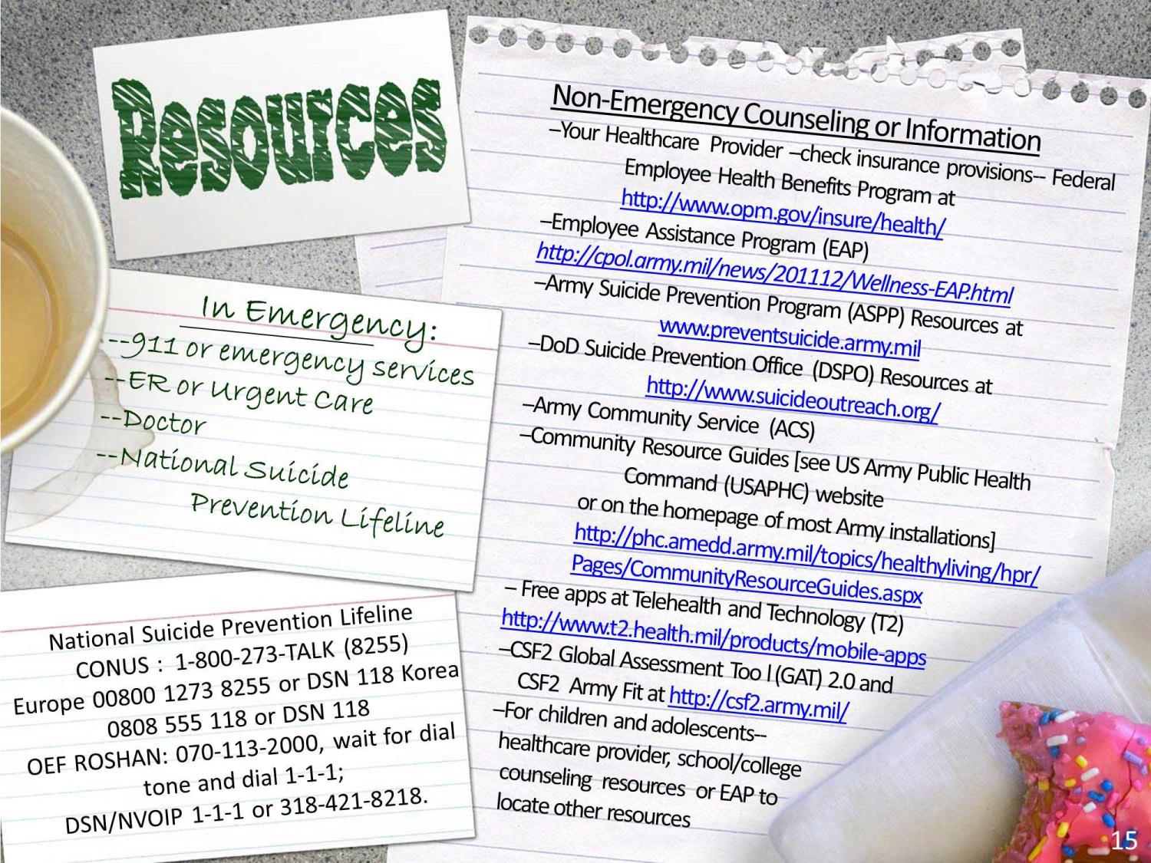
Notes:
Directions (Approximately 5 minutes): Print the below resource and Apps lists which are provided in Appendix E and hand it out along with the local resource list that you obtained. Point out the resources that are available to Army Civilians and ensure that participants put the National Suicide Prevention Lifeline number in their mobile device contact list or make a note of it to record later. Be certain you point out the difference between the resources that are good for information, assistance and counseling and the ones that are useful in a suicide emergency.
Talking Points:
National Suicide Prevention Lifeline 1-800-273-TALK (8255); in Europe 00800 1273 8255 or DSN 118 or in Korea 0808 555 118 or DSN 118 (may not be toll free for all carriers); OEF ROSHAN: 070-113-2000, wait for dial tone and dial 1-1-1; DSN/NVOIP 1-1-1 or 318-421-8218.
Your Healthcare Provider (check health insurance provisions—Federal Employee Health Benefits Program at http://www.opm.gov/insure/health/ )
Army Suicide Prevention Program (ASPP) Resources at www.preventsuicide.army.mil
DoD Suicide Prevention Office (DSPO) at http://www.suicideoutreach.org/
Army Community Service
Employee Assistance Program (EAP) (http://cpol.army.mil/index.html)
CSF2 Global Assessment Too l (GAT) 2.0 and CSF2 Army Fit (http://csf2.army.mil/)
Community Resource Guides (available on the US Army Public Health Command (USAPHC) website or on the homepage of most Army installations) http://phc.amedd.army.mil/topics/healthyliving/hpr/Pages/CommunityResourceGuides.aspx
Free Apps from the National Center for Telehealth and Technology (T2) http://www.t2.health.mil/products/mobile-apps
Healthcare provider or school and college counseling center resources for children and adolescents
Remember that if you are a retiree, veteran, military Family member, or have been deployed for your Army Civilian job, you may be eligible for other military provided mental health and counseling services such as those provided by the Veterans Administration (VA) and Military One Source (MOS). Explore all your options.

Slide 16

USE THIS SPACE TO LIST LOCAL NON-EMERGENCY RESOURCES SUCH AS COUNSELING CENTERS, SUBSTANCE ABUSE COUNSELING, ETC.
Remember if you are a retiree, veteran, military Family member, or have been deployed for your Army Civilian job, you may be eligible for other military-provided mental health and counseling services such as those from the Veterans Administration (VA) or Military One Source (MOS).
LOCAL EMERGENCY SERVICES:
(list here…)
16
1
Notes:
Directions (Approximately 3 minutes): Customize this slide to provide information on resources in your local area (address and telephone number), including counseling, AA, substance abuse programs, hospital emergency rooms, and 24 hour medical service center locations. (If you have printed a list of these resources, hand them out at this time.)
Talking Points:
Point out local resources such as behavioral health centers, counseling services, psychiatric hospitals, substance abuse programs, Alcoholics Anonymous, etc.
Point out location of hospital emergency room and 24 hour medical service centers.
Please take a moment to put the location and phone numbers into your mobile device contact list or make a note to enter them later.

Slide 17

Use these spaces to introduce your guest SMEs (name / title / organization or area of expertise).
Delete any text boxes that you do not use.
name / title / organization or area of expertise
name / title / organization or area of expertise
name / title / organization or area of expertise
17
Notes:
Directions (Approximately 22 minutes): Customize this slide with the names and titles of subject matter experts SME(s) who will present further resource information to the class and answer questions. Remember to provide all guest speakers with the Suggested Speaker Guidelines available in Appendix D to help them prepare their presentation(s). If more than one SME will be present, provide each of them with a suggested amount of time for their presentation to ensure that there will be time for questions and that the class ends on time. (Suggested SMEs include representatives from the Employee Assistance Program, health insurance provider, local counseling or mental health center, or the Suicide Prevention Program Manager (SPPM) for your state, territory, region, or installation.)
Talking Points:
Introduce guest speaker(s) with name , title and organization they represent
At the conclusion of the presentation, moderate a question and answer session
Be sure you provide time guidelines to your SME speaker(s) and ensure they begin and end on time

Slide 18
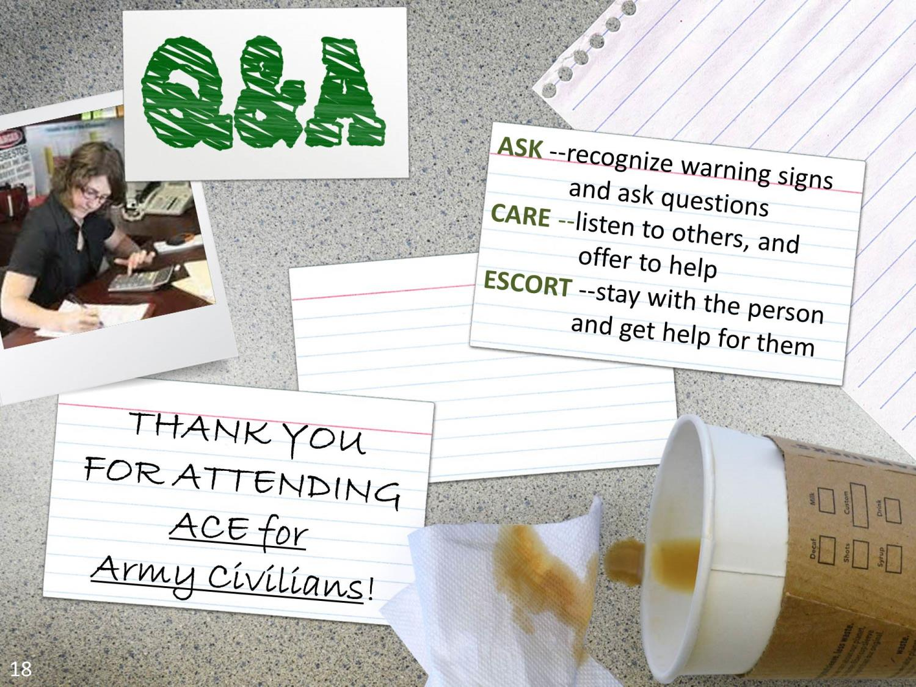
Notes:
Directions (Approximately 3 minutes): Use the talking points to conclude the ACE for Army Civilians class by reminding the training participants what ACE means and encouraging training participants to get help for themselves or another.
Talking Points:
Remember that ACE means ASK, CARE, ESCORT.
ASK means recognize warning signs and ask questions about the stress in the person's life and ask if the person is thinking about suicide.
CARE means help combat stigma, listen to others, and offer to help.
ESCORT means stay with the person and get them to help or bring help to them.
What final questions do you have?
THANK YOU for attending ACE for Army Civilians.
I will be in the classroom if anyone has a further question.

