Slide 1



Facilitator Guide: Trainer notes
Notes:
Ask, Care, Escort
Annual Unit Suicide Prevention Training
Practicing ACE Module
ACE Base +1
September 2023
VERSION 1.3
INSTRUCTOR GUIDE

Slide 2
(Hidden)
Notes:
i-A

Slide 3
(Hidden)
Notes:
i-B
Introduction
The Army Suicide Prevention Program was instituted by CSA General John A. Wickham in 1984. Since that time, suicide prevention and awareness has evolved. In 2009, Ask, Care, Escort (ACE) training was introduced to update existing suicide prevention training and to respond to a rise in suicide rates.
ACE training introduced suicide prevention and intervention concepts that had proven successful outside of the Army. Its primary goals were to increase suicide awareness and improve the ability of Soldiers to identify team members who may be suicidal and get them to help.
In 2018, ACE training was updated to highlight its use not only during a crisis, but also before one occurs by incorporating Army team building and unit cohesion concepts. This training is aligned with the Center for Disease Control and Prevention's strategic comprehensive public health approach to suicide prevention.
In 2022, ACE suicide prevention and intervention material was updated yet again and coined ACE Base + 1. The training now consists of a base module along with a menu of “+1” modules that the unit’s command team can choose from based upon the unit’s needs. Together, the base module and the +1 module make up the mandatory one hour of annual suicide prevention and intervention training.
In addition to the tailored training approach, the training is now designed to be more interactive and conversational. In contrast to a traditional “annual briefing,” ACE Base +1 is an “annual conversation” at platoon level where Soldiers in the platoon are able to discuss how they can take care of one another on a human level as it pertains to suicide prevention and intervention.
In 2023, the Army’s suicide prevention and intervention training expanded to include a tailored curriculum for the Soldiers’ Circle of Support members and DA Civilians. A Soldier’s Circle of Support includes anyone whom the Soldier considers to be a priority within their support system, such as a spouse, significant other, parent, sibling, other family member, mentor, and friend. The intent is that offering Circle of Support members the same knowledge and skills while using the same language and strategies can enable conversation between the Circle of Support member(s) and the Soldier regarding suicide prevention and intervention. What’s more, it can promote effective communication, bolster protective factors like increased cohesion and connection, and increase suicide prevention efforts within the whole Army Family.
ACE Unit Training- Practicing Ask Care Escort

Slide 4
(Hidden)
Notes:
ii-A
ACE Unit Training- Practicing Ask Care Escort
Facilitated discussion and engagement: This training is designed to be facilitated by a single instructor and delivered in an interactive, discussion-based format (rather than conventional lecture or didactic format). Because this module utilizes group interaction, it is highly recommended that it be led by an instructor who is able and willing to elicit participant engagement through facilitating meaningful discussions and practical exercises. The practical exercises are essential in allowing participants the opportunity to try out the Ask, Care, Escort process strategies in a safe, non-threatening environment and develop competence and confidence to use the strategies in real-life scenarios.
Delivered in-person to small groups: The ACE training is intended to be delivered in-person and it is highly recommended that this training be conducted with small groups (fewer than 40). In-person training allows for optimal engagement and also fosters unit cohesion, thus building protective factors which is an aim of the training.
Cohesive efforts: It is strongly recommended that the ACE for Circle of Support training be offered around the same time frame that the Soldiers receive the ACE Unit Training. According to AR 600-63, ACE suicide prevention and intervention training must be offered to Circle of Support members on an annual basis. The ACE Base for Circle of Support module resembles the content and format of the ACE Base module for Soldiers but has been tailored for members of a Soldier’s Circle of Support (e.g., spouse, significant other, parent(s), siblings, extended family, friends, mentors).
Intent

Slide 5
(Hidden)
Notes:
ii-B
Note: Each module should be trained to standard and not to time, it is most effective when time is allowed for in-depth group discussion and participation. To maximize the benefits of this training, allow for extra time for dialogue and interaction.
Training Package Components: The complete “ACE Base +1” training package consists of five PowerPoint® presentations (i.e., ACE Base, Fighting the Stigma, Active Listening, Practicing ACE, and Lethal Means) and a SmartGuide with key information to be discussed for each slide (see notes page iv for SmartGuide overview).
Training Precautions: The ACE suicide prevention and awareness training deals with sensitive information and may trigger painful memories or other issues for training participants. It is possible that someone attending the training may have experienced thoughts of suicide or may have experienced a loved one who has struggled with suicidal thoughts, ideation, or worse – died by suicide.
If you are not a chaplain or behavioral health provider, it is recommended that you have someone from the chaplain’s office or Behavioral Health Services on call during your training session. Be sure to coordinate before the training and obtain their name, title, and consent to act as an immediate resource if needed. Provide them with the date, time, and location of the training; on the day of the training, be sure to have the number(s) at which they can be reached or another plan for reaching them.
Training Requirements: The U.S. Army’s requirement for annual suicide prevention training is to complete one hour of training that includes the “ACE Base” module along with one of the “+1” modules.
The mention of any non-federal entity and/or its products is not to be construed or interpreted, in any manner, as federal endorsement of that non-federal entity or its products.
ACE Unit Training- Practicing Ask Care Escort

Slide 6
(Hidden)
Notes:
iii-A
Training Preparation:
Content: This is the U.S. Army’s mandatory annual suicide prevention training (IAW AR 600-63). The material is based on the most current research and academic literature on suicide prevention and follows educational best practices. The training is designed to enable the instructor to successfully lead participants through suicide prevention concepts with interactive activities and discussions to prompt critical thinking. For the training to be most effective, it is advised that instructors review all content in advance.
When instructing, follow the content as written. Insert personal stories/examples as appropriate. Prompts are written into the SmartGuide to highlight times when personal stories/examples can be most valuable. There are many benefits of sharing a personal story or example. For instance, stories/examples can help a trainer to capture the audience’s attention, gain common ground with the audience, and engage the audience on a deeper level. Most importantly, effective use of personal stories or examples can help participants gain better contextual understanding of the material being taught.
The following guidelines can help ensure effective use of personal stories and examples. The story/example
serves a clear purpose, specifically it reinforces the training objective/content
helps participants to gain a better contextual understanding about the concepts
does not distract participants from the focus of training (e.g., be mindful of using potentially triggering or traumatizing examples/stories)
is simple, concise, and easy to follow/understand
Remember, sharing your personal stories/examples is to benefit the participant, not yourself. The story/example should highlight the content, not you as a person (e.g., avoid the mistake of making the training about yourself). Lastly, it is highly recommended that you practice your stories/examples before using them in a training session. Rehearsing the story/example can improve effective delivery, especially if the story/example is one that could be emotional for you to share.
Flow: This training module is comprised of four main sections.
ACE Unit Training- Practicing Ask Care Escort

Slide 7
(Hidden)
Notes:
iii-B
Training Preparation (continued):
Language: Suicide can be an uncomfortable topic to discuss, and it can be difficult to find the words to talk about it. As researchers continue to learn more about suicide and those impacted by it, the language used continues to evolve. For example, the term “committed suicide” perpetuates the idea that suicide is a criminal act, which can be stigmatizing. Instead, consider the phrase “died by suicide” or “attempted suicide.”
Participants may unintentionally use stigmatizing language, as not everyone understands the harmful impact of these words. It is recommended that during the training, participants are allowed to use the words they feel comfortable with to promote open conversation; however, it is recommended that the instructor supports participant usage of destigmatized language and use those words themselves.
Important concepts: Although ACE Base +1 is an annual training requirement, the training does not have to be conducted or perceived as “just another mandatory briefing.” Instead, it is important that the trainer and participants see the ACE Base + 1 modules as an opportunity for an annual discussion amongst Soldiers and leadership about the way the unit uses these skills and concepts in their day-to-day life and operations.
When Soldiers collectively implement the ACE process, use Active Listening and are intentionally Fighting Stigma, it creates culture of trust and cohesion. Consequently, a culture of trust and cohesion encourages help-seeking behavior; Soldiers know that when they need someone, the Soldiers in the unit will have their back. As the trainer, work to present the material as a facilitated discussion so the Soldiers are learning the material but also learning from and about one another and actively building trust and cohesion.
ACE Unit Training- Practicing Ask Care Escort

Slide 8
(Hidden)
Notes:
iv-A
ACE Training Facilitation Strategies:
Review the SmartGuide prior to the training session. Take notes on when you may use different facilitation strategies to promote an effective learning experience for participants.
ACE Unit Training- Practicing Ask Care Escort

Slide 9
(Hidden)
Notes:
iv-B
ACE Unit Training- Practicing Ask Care Escort

Slide 10
(Hidden)
Notes:
v-A
ACE Unit Training- Practicing Ask Care Escort

Slide 11
(Hidden)
Notes:
v-B

Slide 12
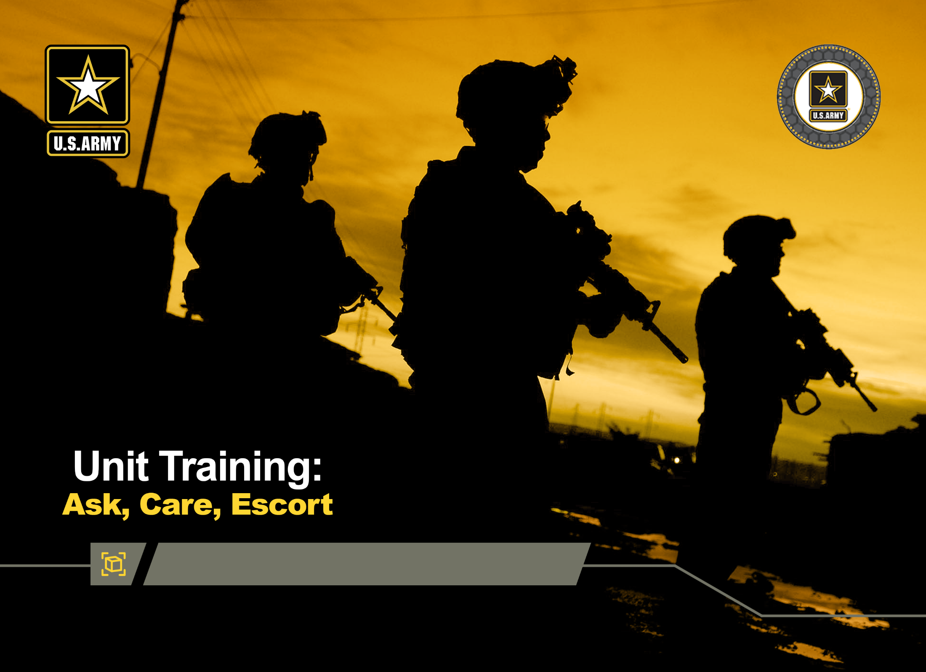



Practicing ACE Module
DPRR
1
Notes:
Record your own notes here:
1-A
ACE Unit Training- Practicing Ask Care Escort

Slide 13
(Hidden)
Notes:
1-B

Slide 14




Concrete Experience
Many service members who have reported having suicidal thoughts or had a suicide attempt since joining the military have indicated that they did not talk to anyone or seek help.
What are some potential reasons that could keep a Soldier from implementing the ASK, CARE, ESCORT process?
2
Notes:
2-A
[?]
ACE Unit Training- Practicing Ask Care Escort
Record your own notes here:

Slide 15
(Hidden)
Notes:
2-B
ACE Unit Training- Practicing Ask Care Escort
Record your own notes here:

Slide 16

Training Purpose
To provide an opportunity to practice ACE and strengthen individual and collective unit suicide prevention skills
ACE techniques and procedures need to be rehearsed to maintain proficiency
3
Notes:
3-A
ACE Unit Training- Practicing Ask Care Escort
Record your own notes here:
[NOTE: The Terminal Learning Objective (TLO) is as follows:
Action: Demonstrate and/or verbalize appropriate application of each phase of the ACE procedures given a scenario.
Condition: In a classroom environment, given training materials
Standard: Participants will, with 100% accuracy as assessed by the instructor
Practice the steps of ACE to increase confidence levels for how and when to apply them
There will be checks on learning throughout the training to ensure the objective and standards are being met.]

Slide 17
(Hidden)
Notes:
3-B
ACE Unit Training- Practicing Ask Care Escort
Record your own notes here:

Slide 18
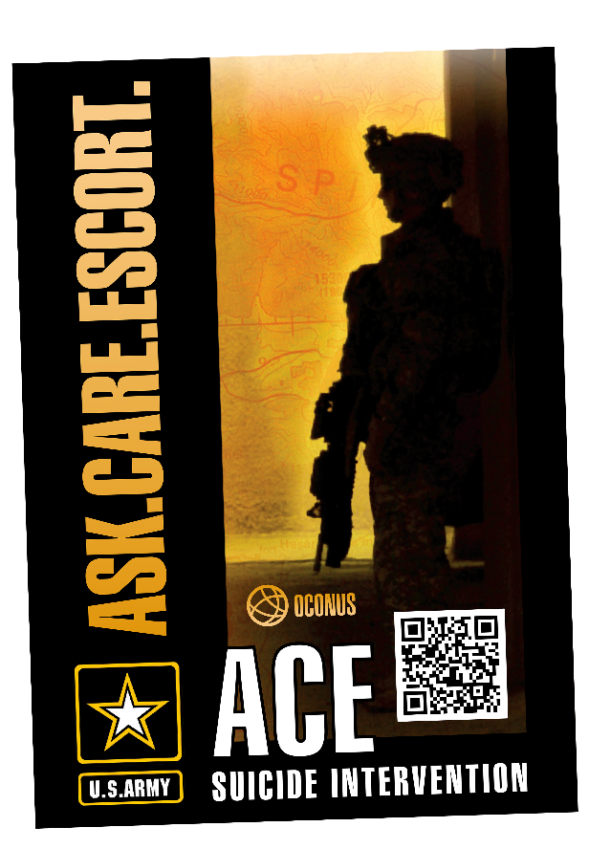
Review of ACE
ACE is an acronym intended to help remember the actions to take when assisting a team member facing a crisis and/or at risk for suicide.
Similar to CPR or Buddy Aid, apply ACE as an immediate response:
Assess the situation by ASKing if help is needed
Offer CARE to stabilize and provide safety
ESCORT to a helping resource to ensure a safe outcome
4
Notes:
4-A
ACE Unit Training- Practicing Ask Care Escort
Record your own notes here:

Slide 19
(Hidden)
Notes:
4-B

Slide 20

Recognize the Signs to Assess the Risk
WARNING SIGNS
  Indicate or signal active suicidal thinking and/or behaviors, meaning they are time sensitive and
  require immediate action
RISK FACTORS
  Events and/or characteristics that indicate the
  potential for suicidal thoughts and/or actions
PROTECTIVE FACTORS
  Behaviors, characteristics, or supports that reduce risk and encourage healthy behaviors
5
Notes:
5-A
ACE Unit Training- Practicing Ask Care Escort
Record your own notes here:

Slide 21
(Hidden)
Notes:
5-B
ACE Unit Training- Practicing Ask Care Escort
Record your own notes here:

Slide 22

Practical Application: Strategies to ASK
What are some strategies a Soldier could use to overcome challenges associated with ASKing or checking in with a fellow Soldier?
6
Notes:
6-A
ACE Unit Training- Practicing Ask Care Escort
[?]
Record your own notes here:

Slide 23
(Hidden)
Notes:
6-B
ACE Unit Training- Practicing Ask Care Escort
Record your own notes here:

Slide 24
Practical Tips: ASK
Be direct
  Asking direct questions will give you the most direct, clear answers
Have strategies to overcome challenges
Trust that the benefits of ASKing outweigh any perceived costs
  It is better to ask and be wrong than to not ask and have something terrible happen
  Checking in with someone shows you have their back, which can help increase your connection and level of trust
7
Notes:
7-A
ACE Unit Training- Practicing Ask Care Escort
Record your own notes here:

Slide 25
(Hidden)
Notes:
7-B

Slide 26


Practical Tips: CARE
ACTIVE LISTENING
EMPATHY
Listening thoughtfully and deliberately to capture the nuances of what the speaker is communicating (ATP 6-22)
The ability to recognize, understand, and appreciate another person’s situation, motives, perspectives, and feelings (adapted from ADP 6-22)
Attentive and open posture
Make appropriate eye contact
Use facial expressions that reflect the speaker’s emotion
Give affirmative nods or affirming responses like “I see” or “go on”
Summarize what is said to ensure understanding
Ask open-ended questions to gain clarity and depth of understanding
Listen with an open mind
Allow the speaker to finish sharing and refrain from giving unsolicited advice or your perspective
Ask thoughtful questions with a genuine curiosity
Acknowledge and accept their feelings as they are without trying to change how they feel
8
Notes:
8-A
ACE Unit Training- Practicing Ask Care Escort
Record your own notes here:

Slide 27
(Hidden)
Notes:
8-B
ACE Unit Training- Practicing Ask Care Escort
Record your own notes here:

Slide 28

Practical Application: Strategies to ESCORT
Establish realistic expectations: The person you are helping may provide resistance.
What are some strategies a Soldier might use to overcome potential challenges or resistance when trying to ESCORT a Soldier to a helping resource?
What are some ESCORT strategies if you are alone with a Soldier in crisis?
  How might you handle the ESCORT process if you are talking to a Soldier in crisis on the phone or over social media?
Group Discussion
9
Notes:
9-A
ACE Unit Training- Practicing Ask Care Escort
[?]
Record your own notes here:

Slide 29
(Hidden)
Notes:
9-B
ACE Unit Training- Practicing Ask Care Escort
Record your own notes here:

Slide 30
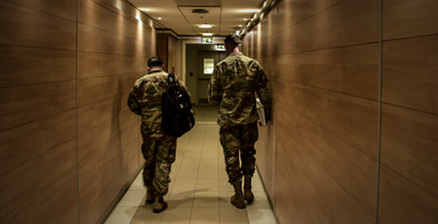
Practical Tips: ESCORT
When someone is in crisis, do not leave them alone, especially if they are suicidal.
10
Notes:
10-A
ACE Unit Training- Practicing Ask Care Escort
Record your own notes here:

Slide 31
(Hidden)
Notes:
10-B

Slide 32

Practical Exercise: Simulation Instructions
Applied Exercises
The purpose of this practical exercise is to provide you an opportunity to practice your ACE skills through a simulation training exercise.
Pair up and determine who will be Partner 1 and Partner 2. During the simulation exercise, one partner will portray someone struggling with a problem and the other will be listening and taking actions (ACE) to respond appropriately.
We will conduct two rounds: Alpha and Bravo. Partner 1 will be practicing ACE first in Alpha round.
Prior to each round, you will be given background information for your specific role and instructions for the simulation exercise.
11
Notes:
11-A
ACE Unit Training- Practicing Ask Care Escort
Record your own notes here:
[NOTE: If the training has an odd number of participants, then a group of 3 will be necessary. In this case, give clear direction for the third person to assume the role as Observer and take notes of sustains and improves to offer valuable feedback to the group.]

Slide 33
(Hidden)
Notes:
11-B
ACE Unit Training- Practicing Ask Care Escort
Record your own notes here:

Slide 34


Practical Exercise: Simulation ALPHA
Applied Exercises
Partner 1
Background: You are with someone you know who has had some recent personal problems and lately appears downcast and is keeping to themselves. They told you their situation seems “hopeless” to them.
Instructions: Employ ACE and practice using active listening and showing empathy for the person sharing their problems.
Partner 2
Background: A fellow Soldier asks if you are okay. Recently, you’ve been going through a lot, such as
Breaking up with a significant other
Not sleeping well
Receiving a negative counseling
Self-medicating (e.g., drinking more to “help” with sleep)
But you have not thought about ending your life.
Instructions: During the conversation, be sure to tell them about your recent difficulties and your changes in mood and behavior.
12
Notes:
12-A
ACE Unit Training- Practicing Ask Care Escort
Record your own notes here:

Slide 35
(Hidden)
Notes:
12-B

Slide 36
Partner Debrief: Simulation ALPHA
Applied Exercises
Use the following questions to guide your feedback to your partner based on their role and responsibilities. You do not need to discuss each one.
What strategy/approach was used to “break the ice” and ASK/initiate conversation? Was it effective?
Did Partner 1 express empathy? If so, how?
What behaviors did Partner 1 use to show they were actively listening?
Did Partner 1 ask a direct question such as “Are you thinking about suicide?”
If so, how did that go?
Partner 1: Did you pick up on any risk factors or warning signs from Partner 2?
What strategy/approach was used to Escort? Was it effective?
13
Notes:
13-A
ACE Unit Training- Practicing Ask Care Escort
Record your own notes here:

Slide 37
(Hidden)
Notes:
13-B

Slide 38
Practical Exercise: Simulation BRAVO
Applied Exercises
Partner 1
Background: A Soldier in your platoon asks if you are okay. Recently you’ve been going through a lot, such as
Accruing a lot of debt and your family is harping on you to figure it out
Worrying over being passed over for promotion
Losing interest in things and can’t concentrate at work or home
You’ve thought of ways to end your life but have not made any specific plans.
Instructions: During the conversation, be sure to tell them about your recent difficulties and your changes in mood and behavior.
Partner 2
Background: A Soldier in your platoon has been acting differently lately. You’ve noticed slight changes over time, and now they appear downcast and preoccupied. Recently this Soldier has said on several occasions, although somewhat sarcastically, that some days are totally hopeless and there’s no point in living.
Instructions: Employ ACE and practice using active listening and showing empathy for the person sharing their problems.
14
Notes:
14-A
ACE Unit Training- Practicing Ask Care Escort
Record your own notes here:

Slide 39
(Hidden)
Notes:
14-B

Slide 40
Partner Debrief: Simulation BRAVO
Partner Debrief: Simulation BRAVO
Applied Exercises
Use the following questions to guide your feedback to your partner based on their role and responsibilities. You do not need to discuss each one.
What strategy/approach was used to “break the ice” and ASK/initiate conversation? Was it effective?
Did Partner 1 express empathy? If so, how?
What behaviors did Partner 1 use to show they were actively listening?
Did Partner 1 ask a direct question such as “Are you thinking about suicide?”
If so, how did that go?
Partner 1: Did you pick up on any risk factors or warning signs from Partner 2?
What strategy/approach was used to Escort? Was it effective?
15
Notes:
15-A
ACE Unit Training- Practicing Ask Care Escort
Record your own notes here:

Slide 41
(Hidden)
Notes:
15-B

Slide 42
After Action Review
Applied Exercises
State the intent of the simulation training exercise
Describe and discuss what happened in the scenarios
  What did it feel like to ask if your partner was considering suicide?
  At any time, was it uncomfortable to ask about the other person’s issues? If so, how did you work through that?
  What differences did you notice in the ACE experience from when the Soldier responded “yes” or “no” to having suicidal ideations?
Review what went well and what could be improved
What were some overall sustains from you and your partner’s use of ACE in the simulation? Improves?
Discuss lessons learned that could be used for a real-life event
What is a key takeaway that you learned from participating in this simulation exercise that you can use to help you prevent suicide in your unit?
16
Notes:
16-A
[?]
ACE Unit Training- Practicing Ask Care Escort
Record your own notes here:

Slide 43
(Hidden)
Notes:
16-B
ACE Unit Training- Practicing Ask Care Escort
Record your own notes here:

Slide 44



Mitigating Suicide Risk with Protective Factors
Techniques that work to mitigate suicide risk:
INDIVIDUAL
UNIT
KEY POINT: Setting conditions to promote cohesion and build trust helps to mitigate the risk for suicide by increasing the chances help is requested before problems become unmanageable.
  Build on successful life management skills
  Maintain connectedness
  Seek a sense of purpose or meaning in life
  Maintain suicide prevention knowledge and intervention skills
  Apply positive leadership skills to promote help-seeking decisions
  Promote and participate in team-building activities that build and sustain high levels of unit cohesion
17
Notes:
17-A
ACE Unit Training- Practicing Ask Care Escort
Record your own notes here:

Slide 45
(Hidden)
Notes:
17-B
ACE Unit Training- Practicing Ask Care Escort
Record your own notes here:

Slide 46



Resources
Non-Emergency Resources
Emergency Resources
Unit Chaplain
Behavioral Health
Battalion Aid Stations
Military OneSource
Psychological Health Resource Center
Real Warriors Campaign
Vet Center Call Center
Army Community Services (ACS)
Army Wellness Center (AWC)
Ready & Resilient Performance Center (R2PC)
Holistic Health & Fitness (H2F) Personnel
Military Family Life Counselor (MFLC)
Chain of Command
Military Police
Emergency Room
Crisis Line: 9-8-8 + 1
Local Emergency: 9-1-1
OCONUS 9-1-1
  Germany: Dial 112
  Italy: Dial 112 or 118
  South Korea: Dial 119
  Japan: Dial 119 or 110
Military & Veteran’s Crisis Line
  Text: 838255
Crisis Text Line
  Text: HOME to 741741
18
Notes:
ACE Unit Training- Practicing Ask Care Escort
Record your own notes here:
18-A

Slide 47
(Hidden)
Notes:
18-B

Slide 48


Next Steps: Plan to Implement
What is one thing you plan to do within the next week or two that can help lower the risk of suicide within your unit or among your friends and family members?
Preventing suicide requires taking proactive steps
19
Notes:
19-A
Record your own notes here:
ACE Unit Training- Practicing Ask Care Escort
[?]

Slide 49
(Hidden)
Notes:
19-B
Record your own notes here:
ACE Unit Training- Practicing Ask Care Escort

Slide 50

Thank You!
As a U.S. Army Soldier, you are on a team and trained to support your battle buddy regardless of the situation.
ACE training strengthens your readiness to support one another in the context of life.
You are an integral part of the Army’s comprehensive and integrated approach to preventing suicide and protecting others from its devastating impacts.
20
Notes:
20-A
ACE Unit Training- Practicing Ask Care Escort
Record your own notes here:

Slide 51
(Hidden)
Notes:
20-B
Record your own notes here:
ACE Unit Training- Practicing Ask Care Escort

Slide 52

Post-Training Survey
https://wrair.gov1.qualtrics.com/jfe/form/SV_aXFrN0d3WYotIiy
Participants: You have just completed
the ACE Practicing ACE module.
Completing the survey will assist the DPRR in determining the effectiveness of training and will inform curriculum revisions during the next update cycle.
If you received the Base module prior to this module, please select the
Base + Practicing ACE option on the survey.
Notes:
Record your own notes here:
ACE Unit Training- Practicing Ask Care Escort

Slide 53
(Hidden)
Notes:
ACE Unit Training- Practicing Ask Care Escort

Slide 54
(Hidden)
Notes:
21-A
References
Army Publications
Department of the Army. (2015). Army Health Promotion (AR-300-63). https://armypubs.army.mil/epubs/DR_pubs/DR_a/pdf/web/ARN15595_R600_63_admin_FINAL.pdf
Department of the Army. (2019). Army Leadership and the Profession (ADP 6-22). https://armypubs.army.mil/epubs/DR_pubs/DR_a/ARN20039-ADP_6-22-001-WEB-0.pdf
Department of the Army. (2015). Army Team Building (ATP 6-22.6). https://armypubs.army.mil/epubs/DR_pubs/DR_a/pdf/web/atp6_22x6%20FINAL.pdf
Department of the Army. (2016). A Leader’s Guide to Soldier Health and Fitness (ATP 6-22.5). https://armypubs.army.mil/epubs/DR_pubs/DR_a/pdf/web/atp6_22x5.pdf
Department of the Army. (2015). Health Promotion, Risk Reduction, and Suicide Prevention (DA PAM 600- 24). https://armypubs.army.mil/epubs/DR_pubs/DR_a/pdf/web/p600_24.pdf
Other Publications
Bowersox, N. W., Jagusch, J., Garlick, J., Chen, J. I., & Pfeiffer, P. N. (2021). Peer-based interventions targeting suicide prevention: A scoping review. American Journal of Community Psychology, 68(1- 2), 232–248. https://doi.org/10.1002/ajcp.12510
Defense Suicide Prevention Office. (2016). Suicide Prevention Training Competency Framework: A competency framework for all members and targeted sub-groups across the Department of Defense. https://www.dspo.mil/Portals/113/Documents/Final%20Signed%20Competency%20
Framework%202016.pdf?ver=2018-02-07-111806-747
Department of Defense. (2020). Annual Suicide Report Calendar Year 2019 (Ref ID. 4-CFF293C). https://www.dspo.mil/Portals/113/Documents/CY2019%20Suicide%20Report/DoD%20Calendar% 20Year%20CY%202019%20Annual%20Suicide%20Report.pdf
Drollinger, T., Comer, L. B., & Warrington, P. T. (2006). Development and validation of the active empathetic listening scale. Psychology & Marketing, 23(2), 161-180. https://doi.org/10.1002/mar.20105
Griffith, J. & Bryan, C. J. (2018). Preventing suicides in the U.S. Military. Psychological Services, 15(3), 251-261. http://dx.doi.org/10.1037/ser0000225
Hangartner, R. B., Totura, C. M. W., Labouliere, C. D., Gryglewicz, K., & Karver, M. S. (2019). Benchmarking the "Question, Persuade, Refer" Program Against Evaluations of Established Suicide Prevention Gatekeeper Trainings. Suicide & Life-Threatening Behavior, 49(2), 353–370. https://doi.org/10.1111/sltb.12430
Litteken, C., & Sale, E. (2018). Long-Term Effectiveness of the Question, Persuade, Refer (QPR) Suicide Prevention Gatekeeper Training Program: Lessons from Missouri. Community Mental Health Journal, 54(3), 282–292. https://doi.org/10.1007/s10597-017-0158-z
ACE Unit Training- Practicing Ask Care Escort

Slide 55
(Hidden)
Notes:
21-B
References (cont.)
Nock, M. K., Deming, C. A., Fullerton, C. S., Gilman, S. E., Goldenberg, M., Kessler, R. C., McCarroll, J. E., McLaughlin, K. A., Peterson, C., Schoenbaum, M., Stanley, B., & Ursano, R. J. (2013). Suicide among soldiers: a review of psychosocial risk and protective factors. Psychiatry, 76(2), 97–125. https://doi.org/10.1521/psyc.2013.76.2.97
Peterson, A. L., Monahan, M. F., Bender, A. M., Gryglewicz, K., & Karver, M. S. (2021). Don't Invite Everyone! Training Variables Impacting the Effectiveness of QPR Trainings. Administration and Policy in Mental Health, 48(2), 343–353. https://doi.org/10.1007/s10488-020-01078-3
Pietrzak, R. H., Johnson, D. C., Goldstein, M. B., Malley, J. C., Rivers, A. J., Morgan, C. A., & Southwick, S. M. (2010). Psychosocial buffers of traumatic stress, depressive symptoms, and psychosocial difficulties in veterans of Operations Enduring Freedom and Iraqi Freedom: the role of resilience, unit support, and postdeployment social support. Journal of Affective Disorders, 120(1-3), 188–192. https://doi.org/10.1016/j.jad.2009.04.015
Rosa, L. (2014). Reach Out! Suicide prevention using QPR (Question, Persuade, Refer). Louisiana Bar Journal, 62(4), 267. https://www.lsba.org/documents/publications/BarJournal/Journal-Dec14- Jan15.pdf
Rudd, M. D., Berman, A. L., Joiner, T. E., Jr, Nock, M. K., Silverman, M. M., Mandrusiak, M., Van Orden, K., & Witte, T. (2006). Warning signs for suicide: theory, research, and clinical applications. Suicide & Life-Threatening Behavior, 36(3), 255–262. https://doi.org/10.1521/suli.2006.36.3.255
Science and Technology Organization. (2018). Military suicide prevention: Report prepared for NATO leadership (Report No. STO-TR-HFM-218). North Atlantic Treaty Organization.
https://apps.dtic.mil/sti/pdfs/AD1062460.pdf
Trachik, B., Tucker, R. P., Ganulin, M. L., Merrill, J. C., LoPresti, M. L., Cabrera, O. A., & Dretsch, M. N. (2020). Leader provided purpose: Military leadership behavior and its association with suicidal ideation. Psychiatry Research, 285, 112722. https://doi.org/10.1016/j.psychres.2019.112722
ACE Unit Training- Practicing Ask Care Escort

