Slide 1


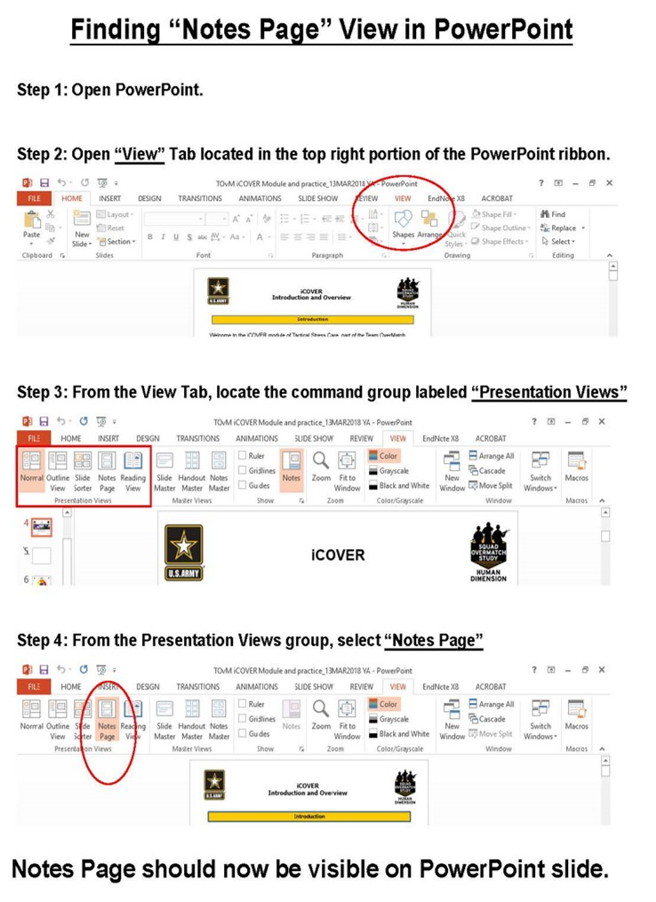
Facilitator Guide: Trainer notes
Notes:
Ask, Care, Escort
Suicide Prevention Training
Fighting Stigma Module
for Circle of Support
ACE Base +1
September 2023
VERSION 1.3
INSTRUCTOR GUIDE

Slide 2
(Hidden)
Notes:
i-A

Slide 3
(Hidden)
Notes:
i-B
Introduction
The Army Suicide Prevention Program was instituted by CSA General John A. Wickham in 1984. Since that time, suicide prevention and awareness has evolved. In 2009, Ask, Care, Escort (ACE) training was introduced to update existing suicide prevention training and to respond to a rise in suicide rates.
ACE training introduced suicide prevention and intervention concepts that had proven successful outside of the Army. Its primary goals were to increase suicide awareness and improve the ability of Soldiers to identify team members who may be suicidal and get them to help.
In 2018, ACE training was updated to highlight its use not only during a crisis, but also before one occurs by incorporating Army team building and unit cohesion concepts. This training is aligned with the Center for Disease Control and Prevention's strategic comprehensive public health approach to suicide prevention.
In 2022, the ACE suicide prevention and intervention material was updated yet again and coined ACE Base + 1. The training now consists of a base module along with a menu of “+1” modules that the unit’s command team can choose from based upon the unit’s needs. Together, the base module and the +1 module make up the mandatory one hour of annual suicide prevention and intervention training.
In addition to the tailored training approach, the training is now designed to be more interactive and conversational. In contrast to a traditional “annual briefing,” ACE Base +1 is an “annual conversation” at platoon level where Soldiers in the platoon are able to discuss how they can take care of one another on a human level as it pertains to suicide prevention and intervention.
In 2023, the Army’s suicide prevention and intervention training expanded to include a tailored curriculum for the Soldiers’ Circle of Support members and DA Civilians. A Soldier’s Circle of Support includes anyone whom the Soldier considers to be a priority within their support system, such as a spouse, significant other, parent, sibling, other family member, mentor, and friend. The intent is that offering Circle of Support members the same knowledge and skills while using the same language and strategies can enable conversation between the Circle of Support member(s) and the Soldier regarding suicide prevention and intervention. What’s more, it can promote effective communication, bolster protective factors like increased cohesion and connection, and increase suicide prevention efforts within the whole Army Family.
ACE Training for Circle of Support- Fighting Stigma Module

Slide 4
(Hidden)
Notes:
ii-A
Cohesive efforts: This ACE module resembles the content and format of the ACE Base module for Soldiers but has been tailored for members of a Soldier’s Circle of Support (e.g., spouse, significant other, parent(s), siblings, extended family, friends, mentors). It is strongly recommended that this training be offered around the same time frame that their Soldiers receive the ACE Unit Training. According to AR 600-63, ACE suicide prevention and intervention training must be offered to Circle of Support members on an annual basis.
A majority of the examples, discussions, and activities are focused on how a Circle of Support member might apply ACE concepts with their Soldier. The Soldier-focused examples are not to discount the importance of other people (e.g., family members, friends) or relationships that participants have with others; instead, it is done intentionally to keep the training focused on similar learning concepts. Also, it is the most universally relevant focus given every participant attending is there due to having vested interest in a Soldier.
Facilitated discussion and engagement: This training is designed to be facilitated by a single instructor and delivered in an interactive, discussion-based format (rather than conventional lecture or didactic format). Because this module utilizes group interaction, it is highly recommended that it be led by an instructor who is able and willing to elicit participant engagement through facilitating meaningful discussions and practical exercises. The practical exercises are essential in allowing participants the opportunity to try out the Ask, Care, Escort process strategies in a safe, non-threatening environment and develop competence and confidence to use the strategies in real-life scenarios.
Delivered in-person to small groups: The ACE training for Circle of Support is intended to be delivered in person and it is highly recommended that this training be conducted with small groups (fewer than 40). In-person training allows for optimal engagement and also fosters relationship building amidst the participants. For example, new friendships and support networks may be established among those attending this class. However, there may be circumstances that warrant a virtual training option in order to be realistic and inclusive to all Circle of Support members who wish to participate (e.g., Circle of Support members being geographically scattered, child-care constraints, work schedules). Trainers and command teams are advised to use their discretion to determine the best mode of delivery without compromising its value.
Intent
ACE Training for Circle of Support- Fighting Stigma Module

Slide 5
(Hidden)
Notes:
ii-B
Note: Each module should be trained to standard and not to time, it is most effective when time is allowed for in-depth group discussion and participation. To maximize the benefits of this training, allow for extra time for dialogue and interaction.
Training Package Components: The complete “ACE Base +1” training package consists of five PowerPoint® presentations (i.e., ACE Base, Fighting the Stigma, Active Listening, Practicing ACE, and Lethal Means) and a SmartGuide with key information to be discussed for each slide (see notes page iv for SmartGuide overview).
Training Precautions: The ACE suicide prevention and awareness training deals with sensitive information and may trigger painful memories or other issues for training participants. It is possible that someone attending the training may have experienced thoughts of suicide or may have experienced a loved one who has struggled with suicidal thoughts, ideation, or worse – died by suicide.
If you are not a chaplain or behavioral health provider, it is recommended that you have someone from the chaplain’s office or Behavioral Health Services on call during your training session. Be sure to coordinate before the training and obtain their name, title, and consent to act as an immediate resource if needed. Provide them with the date, time, and location of the training; on the day of the training, be sure to have the number(s) at which they can be reached or another plan for reaching them.
Training Requirements: The U.S. Army’s requirement for annual suicide prevention training is for Soldiers to complete one hour of training that includes the “ACE Base” module along with one of the “+1” modules, and for the Circle of Support members to be offered annual training as well.
The mention of any non-federal entity and/or its products is not to be construed or interpreted, in any manner, as federal endorsement of that non-federal entity or its products.
ACE Training for Circle of Support- Fighting Stigma Module

Slide 6
(Hidden)
Notes:
iii-A
ACE Training for Circle of Support- Fighting Stigma Module
Training Preparation:
Content: ACE Training is the U.S. Army’s annual suicide prevention training, which is mandatory for Soldiers (IAW AR 600-63) and to be made available to Circle of Support members. The material is based on the most current research and academic literature on suicide prevention and follows educational best practices. The training is designed to enable the instructor to successfully lead participants through suicide prevention concepts with interactive activities and discussions to prompt critical thinking. For the training to be most effective, it is advised that instructors review all content in advance.
When instructing, follow the content as written. Insert personal stories/examples as appropriate. Prompts are written into the SmartGuide to highlight times when personal stories/examples can be most valuable. There are many benefits of sharing a personal story or example. For instance, stories/examples can help a trainer to capture the audience’s attention, gain common ground with the audience, and engage the audience on a deeper level. Most importantly, effective use of personal stories or examples can help participants gain better contextual understanding of the material being taught.
The following guidelines can help ensure effective use of personal stories and examples. The story/example
serves a clear purpose, specifically it reinforces the training objective/content
helps participants to gain a better contextual understanding about the concepts
does not distract participants from the focus of training (e.g., be mindful of using potentially triggering or traumatizing examples/stories)
is simple, concise, and easy to follow/understand
Remember, sharing your personal stories/examples is to benefit the participant, not yourself. The story/example should highlight the content, not you as a person (e.g., avoid the mistake of making the training about yourself). Lastly, it is highly recommended that you practice your stories/examples before using them in a training session. Rehearsing the story/example can improve effective delivery, especially if the story/example is one that could be emotional for you to share.
Flow: This training module is comprised of four main sections.

Slide 7
(Hidden)
Notes:
iii-B
Training Preparation (continued):
Language: Suicide can be an uncomfortable topic to discuss, and it can be difficult to find the words to talk about it. As researchers continue to learn more about suicide and those impacted by it, the language used continues to evolve. For example, the term “committed suicide” perpetuates the idea that suicide is a criminal act, which can be stigmatizing. Instead, consider the phrase “died by suicide” or “attempted suicide.”
Participants may unintentionally use stigmatizing language, as not everyone understands the harmful impact of these words. It is recommended that during the training, participants are allowed to use the words they feel comfortable with to promote open conversation; however, it is recommended that the instructor supports participant usage of destigmatized language and use those words themselves.
Important concepts: When Soldiers and Circle of Support members collectively implement the ACE process, use Active Listening and intentionally Fight the Stigma, it creates culture of trust and cohesion. Consequently, a culture of trust and cohesion encourages help-seeking behavior; Soldiers and Circle of Support members know that when they need someone, other members of the Army Family (e.g., Soldiers in the unit, Circle of Support members, DA Civilians) will have their back. As the trainer, work to present the material as a facilitated discussion so the participants are learning the material but also learning from one another and potentially growing their support network.
ACE Training for Circle of Support- Fighting Stigma Module

Slide 8
(Hidden)
Notes:
iv-A
ACE Training Facilitation Strategies:
Review the SmartGuide prior to the training session. Take notes on when you may use different facilitation strategies to promote an effective learning experience for participants.
ACE Training for Circle of Support- Fighting Stigma Module

Slide 9
(Hidden)
Notes:
iv-B
ACE Training for Circle of Support- Fighting Stigma Module

Slide 10
(Hidden)
Notes:
v-A
ACE Training for Circle of Support- Fighting Stigma Module

Slide 11
(Hidden)
Notes:
v-B

Slide 12
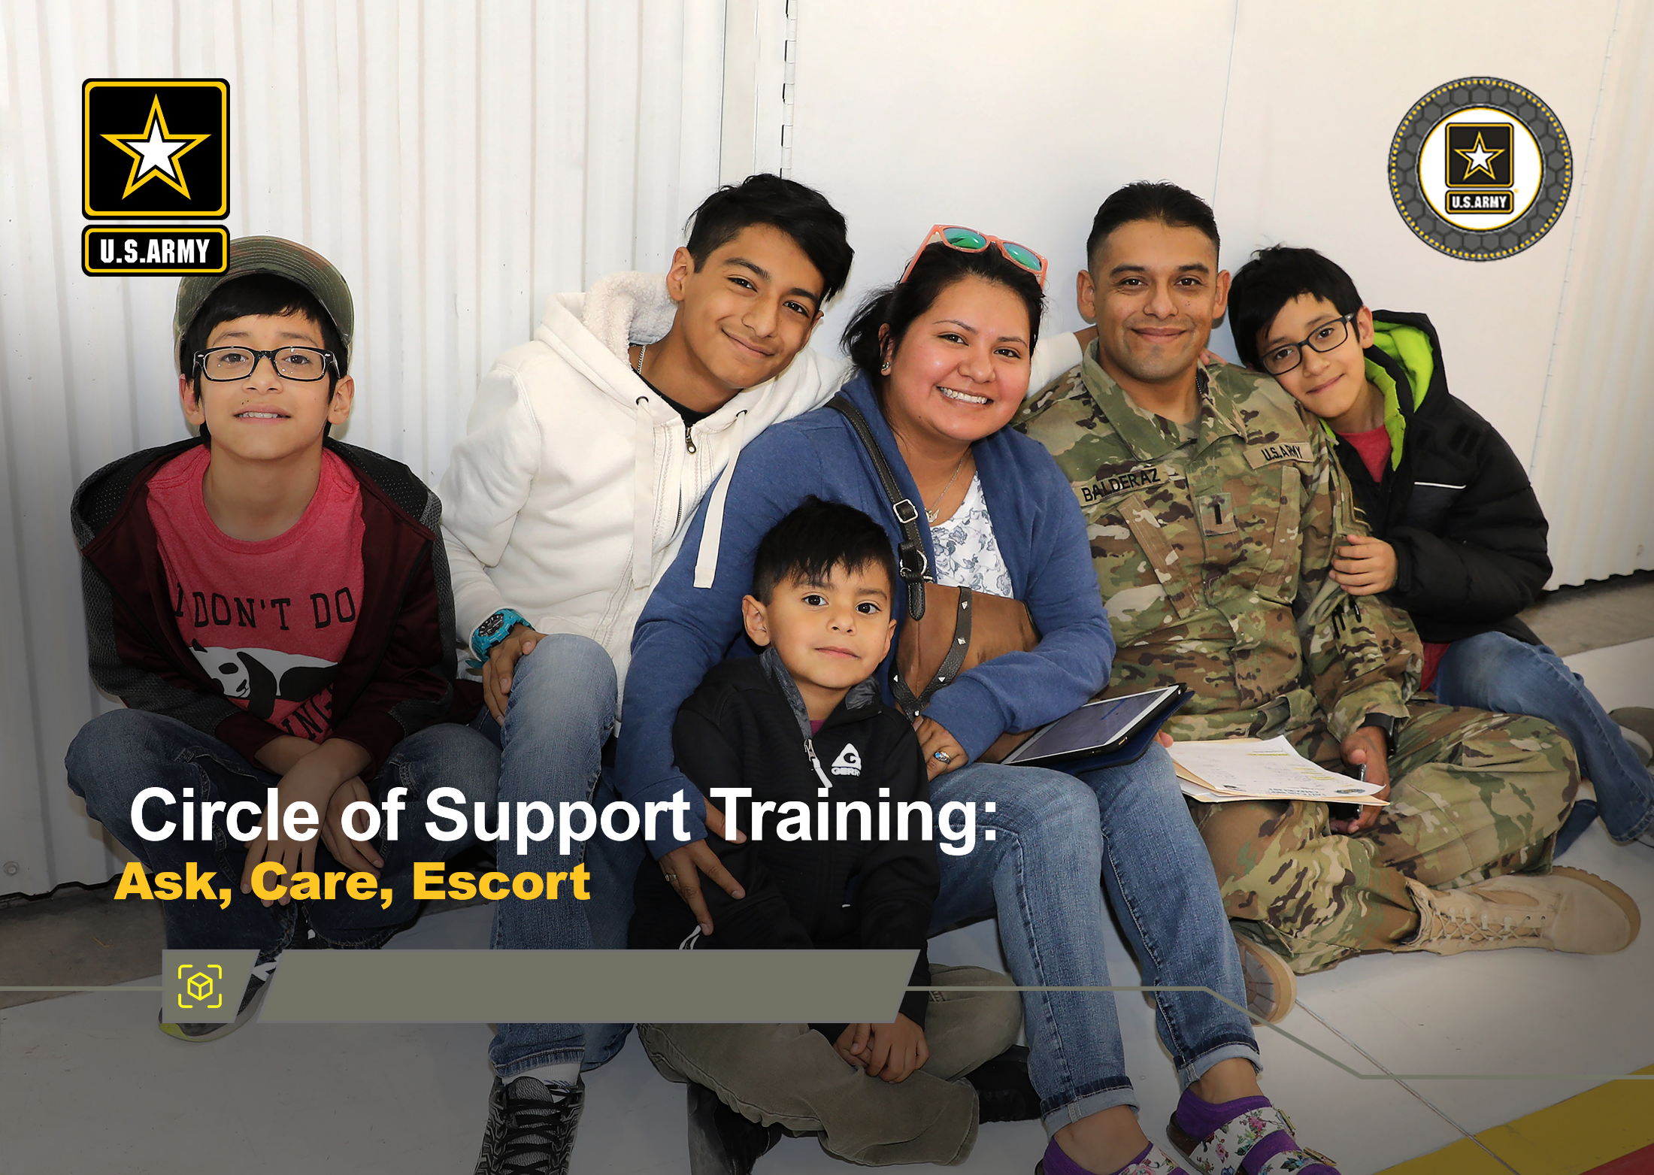



Fighting Stigma Module
DPRR
1
Notes:
Record your own notes here:
1-A
ACE Training for Circle of Support- Fighting Stigma Module

Slide 13
(Hidden)
Notes:
1-B

Slide 14




Concrete Experience
Many service members who have reported having suicidal thoughts or had a suicide attempt since joining the military have indicated that they did not talk to anyone or seek help.
What are some reasons that might contribute to a person not reaching out or seeking help?
2
Notes:
2-A
[?]
Record your own notes here:
ACE Training for Circle of Support- Fighting Stigma Module

Slide 15
(Hidden)
Notes:
2-B
Record your own notes here:
ACE Training for Circle of Support- Fighting Stigma Module

Slide 16
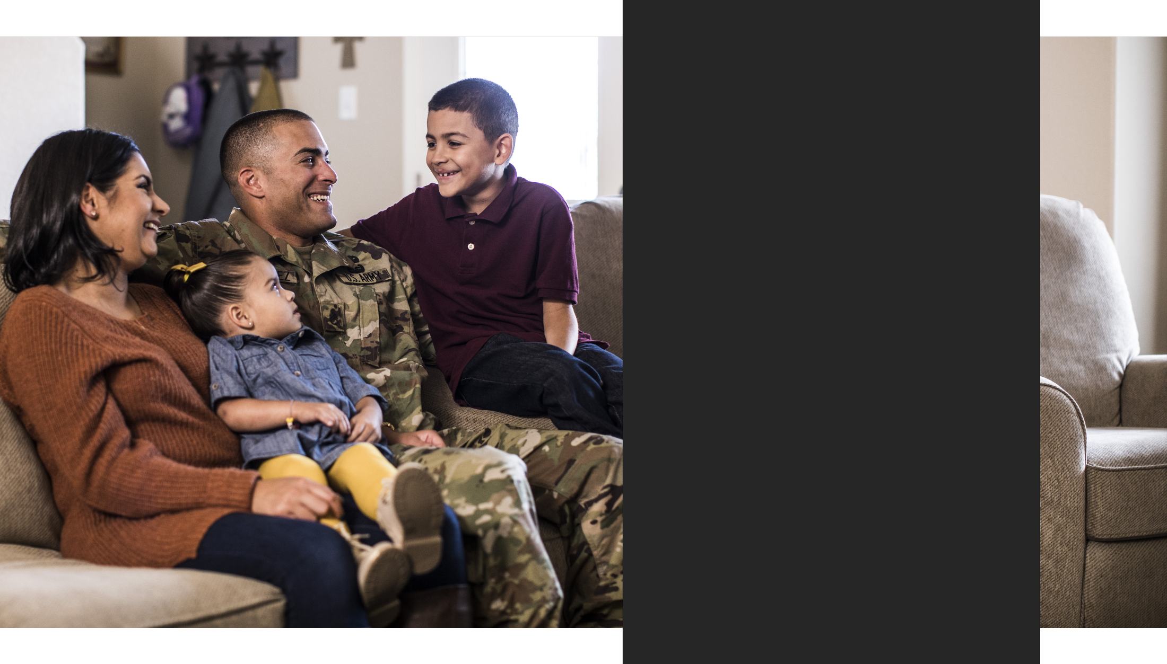
Training Purpose
To enhance Circle of Support members’ ability to recognize and fight stigma and build trust and cohesive relationships to help prevent suicide within their families and communities
3
Notes:
3-A
Record your own notes here:
ACE Training for Circle of Support- Fighting Stigma Module

Slide 17
(Hidden)
Notes:
3-B
Record your own notes here:
ACE Training for Circle of Support- Fighting Stigma Module

Slide 18

What is Stigma?
Stigma is the negative attitude toward people or ideas based on certain characteristics such as one’s mental or physical health or social attributes that might distinguish them from others in the group.
Public stigma
Self-stigma
Negative attitudes about certain behaviors or traits have been internalized; the person adopts a negative view of themselves
Negative or discriminatory attitudes others hold about certain behaviors or traits
4
Notes:
4-A
[?]
Record your own notes here:
ACE Training for Circle of Support- Fighting Stigma Module

Slide 19
(Hidden)
Notes:
4-B
Record your own notes here:
ACE Training for Circle of Support- Fighting Stigma Module

Slide 20

Impact of Stigma
Impact of Stigma
What impact does stigma have on Soldiers and Circle of Support members?
Stigma undermines relationships by negatively impacting trust and feelings of psychological safety within the relationship or environment
Stigma is one of the main barriers for people getting the help and support they need when facing life challenges
Not seeking help early – or at all – can increase a person’s risk for crisis, and subsequently contribute to a greater risk for suicidal thinking and/or behaviors
5
Notes:
5-A
[?]
Record your own notes here:
ACE Training for Circle of Support- Fighting Stigma Module

Slide 21
(Hidden)
Notes:
5-B
Record your own notes here:
ACE Training for Circle of Support- Fighting Stigma Module

Slide 22




Fighting Stigma
When a person senses others in their environment to be supportive of mental health, then the person is more likely to talk about their problems with others and to seek help from mental health professionals.
LEARN
How have you seen other people in your family, community, or society at large fight against stigma?
CHALLENGE
CONNECT
6
Notes:
6-A
[?]
Record your own notes here:
ACE Training for Circle of Support- Fighting Stigma Module

Slide 23
(Hidden)
Notes:
6-B
Record your own notes here:
ACE Training for Circle of Support- Fighting Stigma Module

Slide 24

Tactics to Fighting Stigma
LEARN - Be open to learn, take initiative to educate yourself about people and experiences different than your own to gain a deeper understanding.
LEARN
CONNECT - Be a reliable community member, promote strong peer bonds and a sense of team unity, and demonstrate concern for each other.
CHALLENGE
CONNECT
CHALLENGE - Make on-the-spot corrections, challenge self-beliefs, and lead by example with your actions.
You can tap into other tactics and/or draw upon personal values to help you overcome potential discomfort in using one of the stigma-fighting tactics.
7
Notes:
7-A
Record your own notes here:
ACE Training for Circle of Support- Fighting Stigma Module

Slide 25
(Hidden)
Notes:
7-B
Record your own notes here:
ACE Training for Circle of Support- Fighting Stigma Module

Slide 26

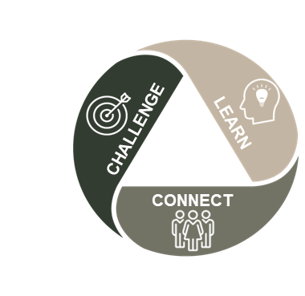
Fighting Stigma: Practical Exercise 1
Part 1:
While attending a local BBQ, you are sitting at a picnic table with several of your friends. The conversation turns onto the topic of a local teenager who attempted suicide. It starts out as being compassionate, but changes to be about how weak and selfish a person must be to try something so awful.
What might a person with your knowledge of stigma and suicide prevention and intervention do in this situation?
8
Notes:
8-A
[?]
Record your own notes here:
[NOTE: Encourage small groups of 3-5 participants as this size promotes a task-focus and optimal engagement from all members.]
ACE Training for Circle of Support- Fighting Stigma Module

Slide 27
(Hidden)
Notes:
8-B
Record your own notes here:
ACE Training for Circle of Support- Fighting Stigma Module

Slide 28
Fighting Stigma: Practical Exercise 2
Part 2:
A few moments after you speak up to educate, challenge, and connect with the people at the table on what can bring a person to a suicide attempt, people naturally get up from the table and go their separate ways. In the moment, it seemed that everyone was accepting of your comments and have gone on with the BBQ and all its activities, but you notice that one individual, Sam, has returned to the table and is looking off into the distance away from the gathering.
How could a person use the steps of ACE to check in on Sam?
9
Notes:
9-A
[?]
Record your own notes here:
ACE Training for Circle of Support- Fighting Stigma Module

Slide 29
(Hidden)
Notes:
9-B
Record your own notes here:
ACE Training for Circle of Support- Fighting Stigma Module

Slide 30
Fighting Stigma: Practical Exercise 3
Part 3:
Using the concepts of ACE, through asking questions and actively listening to Sam, you discover that Sam is friends with the teenager’s family. The views spoken by the people at the table have caused Sam to re-experience the anguish from learning about the attempt.
What actions might a person take next to best support Sam?
10
Notes:
10-A
[?]
Record your own notes here:
ACE Training for Circle of Support- Fighting Stigma Module

Slide 31
(Hidden)
Notes:
10-B
Record your own notes here:
ACE Training for Circle of Support- Fighting Stigma Module

Slide 32
Practical Application
What specific actions will you take to fight stigma within your family or local community?
LEARN
Fighting stigma within one’s family or fighting public stigma often starts with taking a pause to look inward.
During challenging times, draw on your personal values (or Army Values) for motivation to engage in stigma-reducing behaviors and in the ACE process.
CHALLENGE
CONNECT
11
Notes:
11-A
[?]
Record your own notes here:
ACE Training for Circle of Support- Fighting Stigma Module

Slide 33
(Hidden)
Notes:
11-B
Record your own notes here:
ACE Training for Circle of Support- Fighting Stigma Module

Slide 34





Fighting Stigma and Suicide Prevention
Fighting stigma helps to lower the risk of suicide;
it shows you CARE!
Lower
Suicide Risk
Fight
Stigma
Improve
Trust
Improve
Cohesion
Increase
Help-Seeking
12
Notes:
12-A
Record your own notes here:
ACE Training for Circle of Support- Fighting Stigma Module

Slide 35
(Hidden)
Notes:
12-B
Record your own notes here:
ACE Training for Circle of Support- Fighting Stigma Module

Slide 36
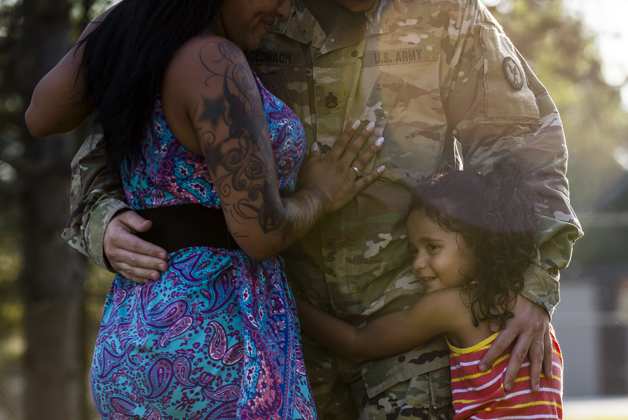
Next Steps: Plan to Implement
What is one thing you plan to do within the next week or two that can help lower the risk of suicide of those in your Circle of Support?
Preventing suicide requires taking proactive steps
13
Notes:
13-A
Record your own notes here:
ACE Training for Circle of Support- Fighting Stigma Module

Slide 37
(Hidden)
Notes:
13-B
Record your own notes here:
ACE Training for Circle of Support- Fighting Stigma Module

Slide 38
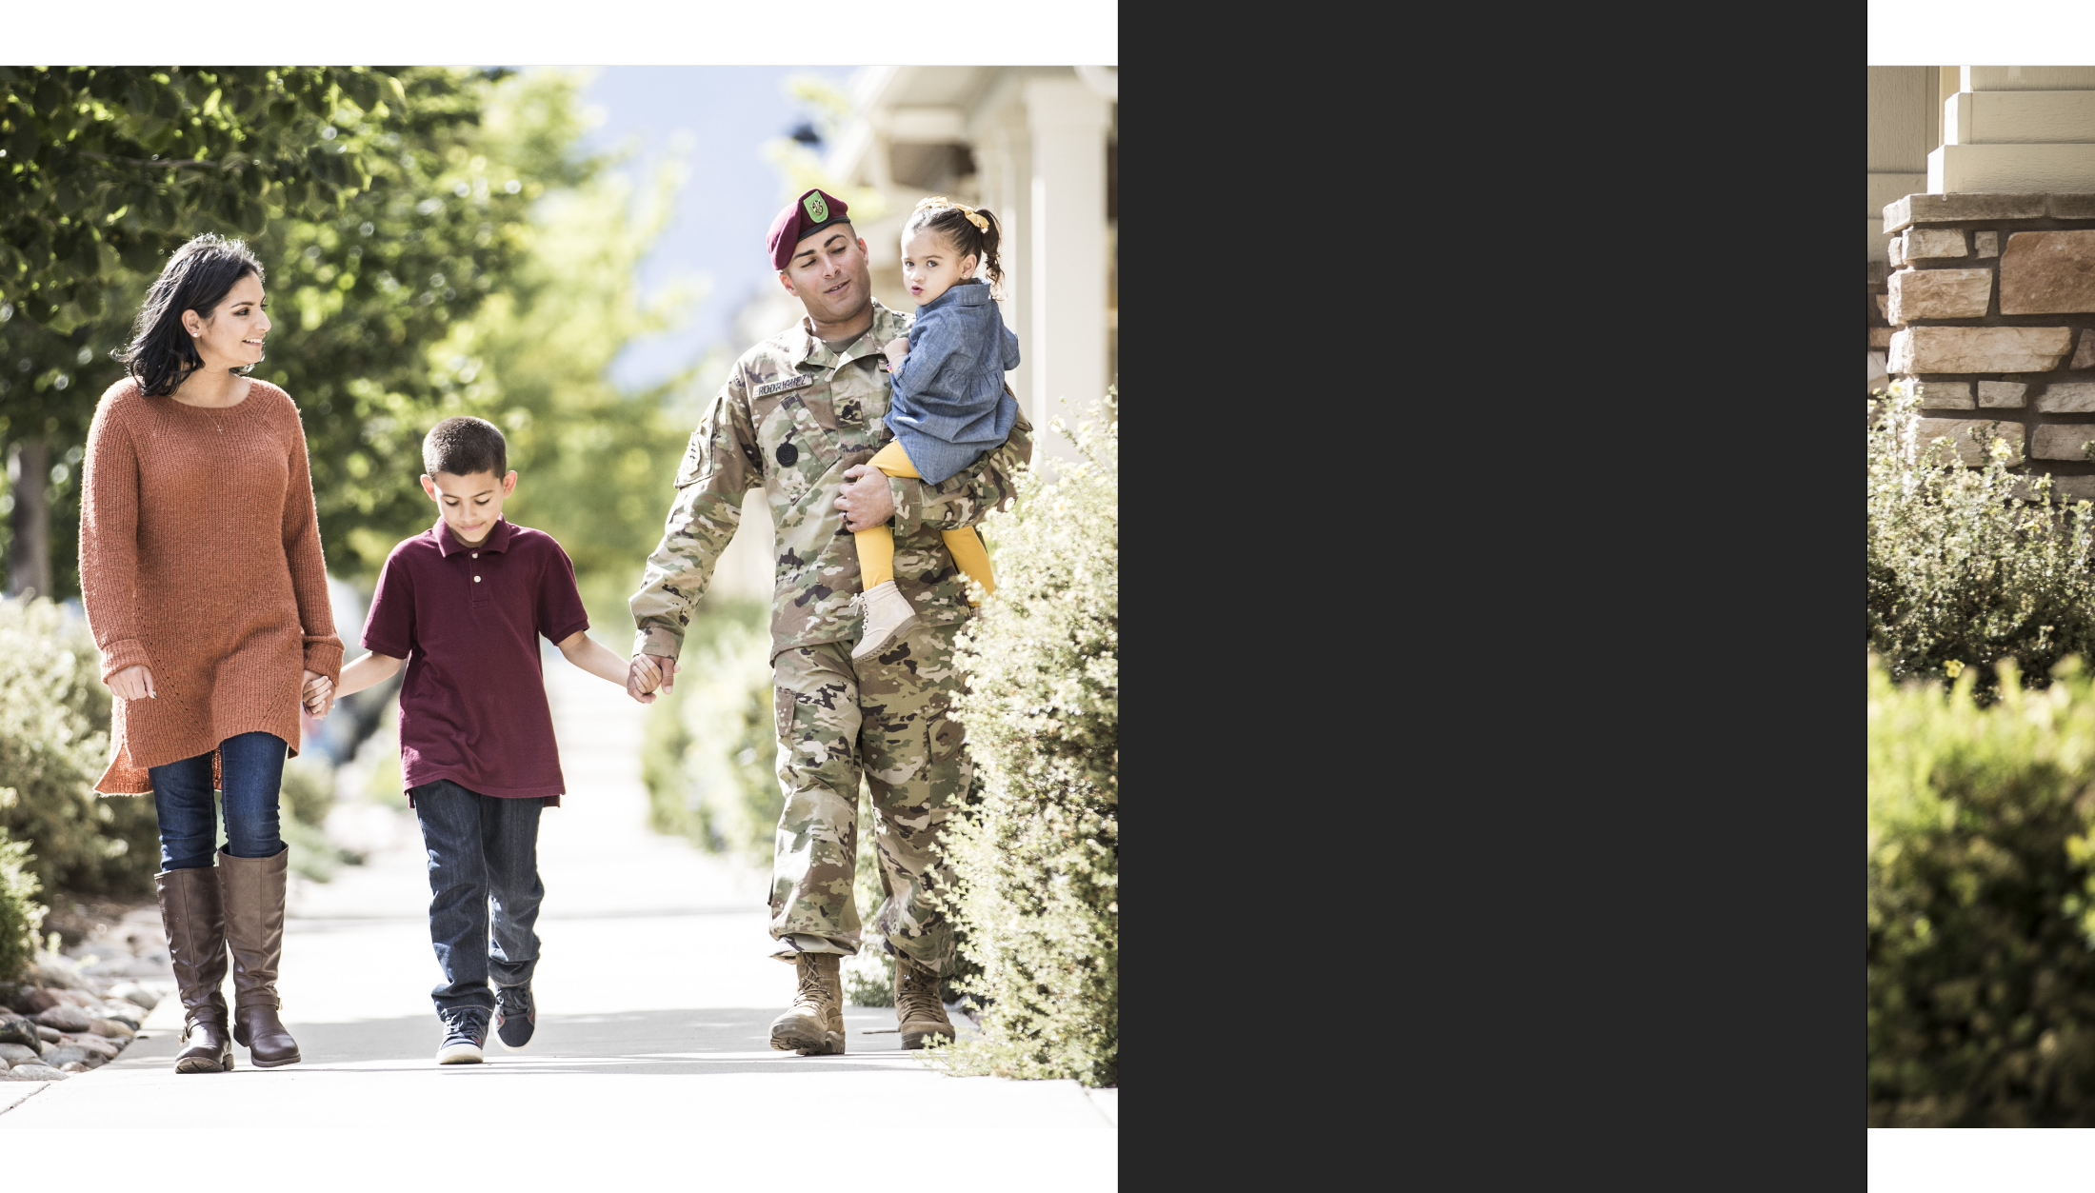
Fighting Stigma Makes a Difference
You are now armed with tactics to fight against stigma and aid the suicide prevention efforts of your family, community, and the Army.
Army policies are changing to be more supportive of Soldiers seeking help, but true change happens at the personal level.
Thank You!
14
Notes:
14-A
Record your own notes here:
ACE Training for Circle of Support- Fighting Stigma Module

Slide 39
(Hidden)
Notes:
14-B
Record your own notes here:
ACE Training for Circle of Support- Fighting Stigma Module

Slide 40
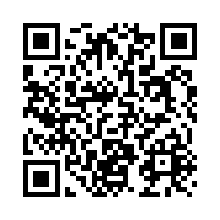
Post-Training Survey
https://wrair.gov1.qualtrics.com/jfe/form/SV_aXFrN0d3WYotIiy
Participants: You have just completed
the ACE Fighting Stigma module.
Completing the survey will assist the DPRR in determining the effectiveness of training and will inform curriculum revisions during the next update cycle.
If you received the Base module prior to this module, please select the
Base + Fighting Stigma option on the survey.
Notes:
Record your own notes here:
ACE Training for Circle of Support- Fighting Stigma Module
15-A

Slide 41
(Hidden)
Notes:
15-B

Slide 42
(Hidden)
Notes:
16-A
References
Army Publications
Department of the Army. (2019). Army Leadership and the Profession (ADP 6-22).
https://armypubs.army.mil/epubs/DR_pubs/DR_a/ARN20039-ADP_6-22-001-WEB-0.pdf
Department of the Army. (2015). Army Team Building (ATP 6-22.6).
https://armypubs.army.mil/epubs/DR_pubs/DR_a/pdf/web/atp6_22x6%20FINAL.pdf
Department of the Army. (2016). A Leaders’ Guide to Soldier Health and Fitness (ATP 6-22.5). https://armypubs.army.mil/epubs/DR_pubs/DR_a/pdf/web/atp6_22x5.pdf
Department of the Army. (2015). Health Promotion, Risk Reduction, and Suicide Prevention (DA PAM 600-24). https://armypubs.army.mil/epubs/DR_pubs/DR_a/pdf/web/p600_24.pdf
Department of the Army. (2020). The Noncommissioned Officer Guide (TC 7-22.7).
https://armypubs.army.mil/epubs/DR_pubs/DR_a/pdf/web/ARN20340_TC%207- 22x7%20FINAL%20WEB.pdf
Other Publications
Arrabito, G R., & A.S. Leung. (2014). Combating the impact of stigma on physically injured and mentally ill Canadian Armed Forces (CAF) members. Canadian Military Journal, 14(2):25-35.
Retrieved November 10, 2022, from
http://www.journal.forces.gc.ca/vol14/no2/PDF/CMJ142Ep25.pdf
Britt, T. W., Wilson, C. A., Sawhney, G., & Black, K. J. (2020). Perceived unit climate of support for mental health as a predictor of stigma, beliefs about treatment, and help-seeking behaviors among military personnel. Psychological Services, 17(2), 141–150. https://doi.org/10.1037/ser0000362
Britt, T. W., Wright, K. M., & Moore, D. (2012). Leadership as a predictor of stigma and practical barriers toward receiving mental health treatment: a multilevel approach. Psychological Services, 9(1), 26–37. https://doi.org/10.1037/a0026412
Maiuolo, M., Deane, F. P., & Ciarrochi, J. (2019). Parental authoritativeness, social support and help-seeking for mental health problems in adolescents. Journal of Youth and Adolescence, 48, 1056-1067.
Meisenbach, R.J. (2010). Stigma management communication: A theory and agenda for applied research on how individuals manage moments of stigmatized identity. Journal of Applied Communication Research 38(3):268-292. https://doi.org/10.1080/00909882.2010.490841
Military. Journal of Mental Health, 21(3), 264–273. Ben-Zeev, D., Corrigan, P. W., Britt, T. W., & Langford, L. (2012). Stigma of mental illness and service use in the https://doi.org/10.3109/09638237.2011.621468
Office of the Chairman of the Joint Chiefs of Staff. (2014). Veteran Stereotypes: A Closer Look. Office of the Chairman of the Joint Chiefs of Staff. https://www.jcs.mil/Portals/36/Documents/CORe/141024_veteran_stereotypes.pdf
Smith, R.A. (2007). Language of the lost: An explication of stigma communication. Communication Theory, 17(4):462-485. https://doi.org/10.1111/j.1468-2885.2007.00307.x
ACE Training for Circle of Support- Fighting Stigma Module

Slide 43
(Hidden)
Notes:
16-B

